Slide 1

BITCOIN İLE ETKİLEŞİM
CÜZDANLAR, MADENCİLİK…
AVA PAYMAN
NATHAN ZHANG

Slide 2

DERS İÇERİĞİ
01
Kullanıcı Tipleri
02
Cüzdanlar
03
Cüzdan Mekaniği
04
Madencilik
05
Gerçek Dünyada Madencilik

Slide 3

Kullanıcı Tipleri

Slide 4
TYPES OF USERS
Tam Düğümler
Her istemci madenci değildir
Güçlü bir bilgisayarım yoksa ?
Her istemci tüm blokzincirine sahip değildir (280+ GB)
Telefonumla bitcoin göndermek istesem ne olur ?
Her istemci doğrudan ağa bağlı değildir
Düzenli işlemler (tx) yapmam gerekmiyorsa?
Her istemcinin cüzdanı yoktur
Ayrı bir cüzdan istemcim varsa?
AUTHOR: RUSTIE LIN

Slide 5
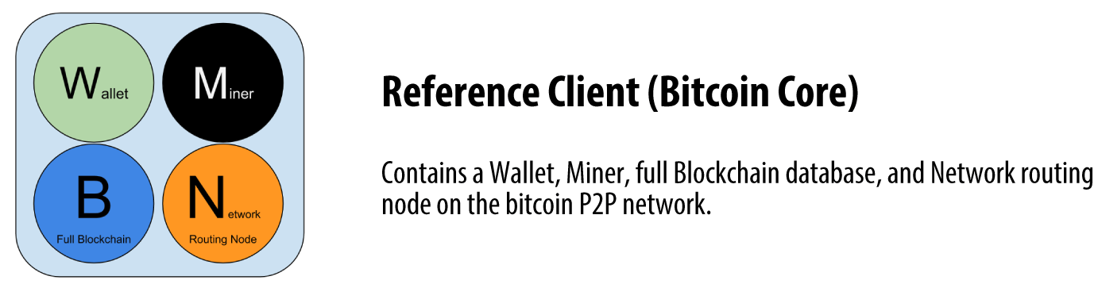
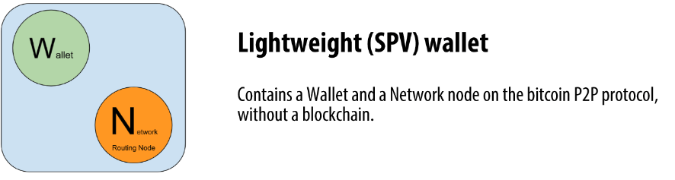
TYPES OF USERS
Hafif Düğümler (SPV Nodes)
Basit Ödeme Doğrulaması (SPV), tüm bloğu indirmeden belirli işlemlerin bir bloğa dahil edilip edilmediğini doğrulama yöntemidir.
Yanlızca işlemlerinizi takip edin
Hafif istemciler
Özel anahtarların kontrolü sizde
Bilgilerin doğruluğunu onaylamak için diğer düğümlere güvenirler
SPV, güvenli ve güvenilirdir ve işlemlerin hızlı bir şekilde doğrulanmasını sağlar
Image source: http://bitcoinbook-builds.mkvd.net/translations/vi/chapter-6.html
AUTHOR: RUSTIE LIN

Slide 6
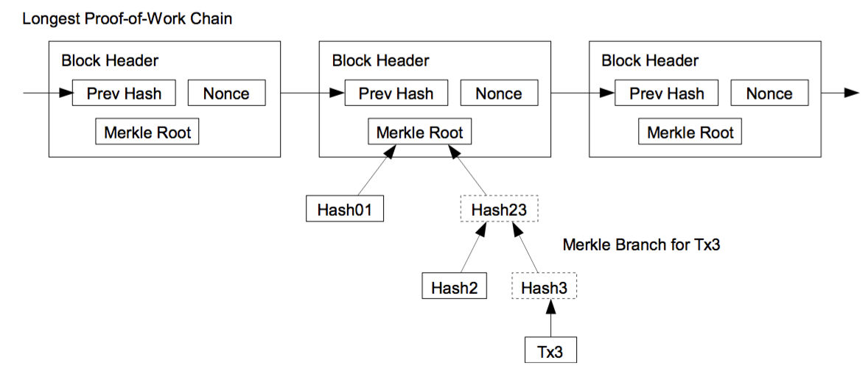
TYPES OF USERS
Basit Ödeme Doğrulaması
Varsayım: Gelen blok başlıkları yanlış bir zincirden değil
Birçok farklı düğüme bağlanın
Uzun vadede, zincir muhtemelen dürüsttür
Tüm blok zincirini telefonunuza koymayı gerçekten göze alamazsınız, bu nedenle ince bir istemciye sahip olmak iyi bir yöntem olur
Yerel olarak depolanır
Tam düğümlerden sorgulandı
Gelen tx
Image source: Mastering Bitcoin
AUTHOR: RUSTIE LIN & MAX FANG

Slide 7
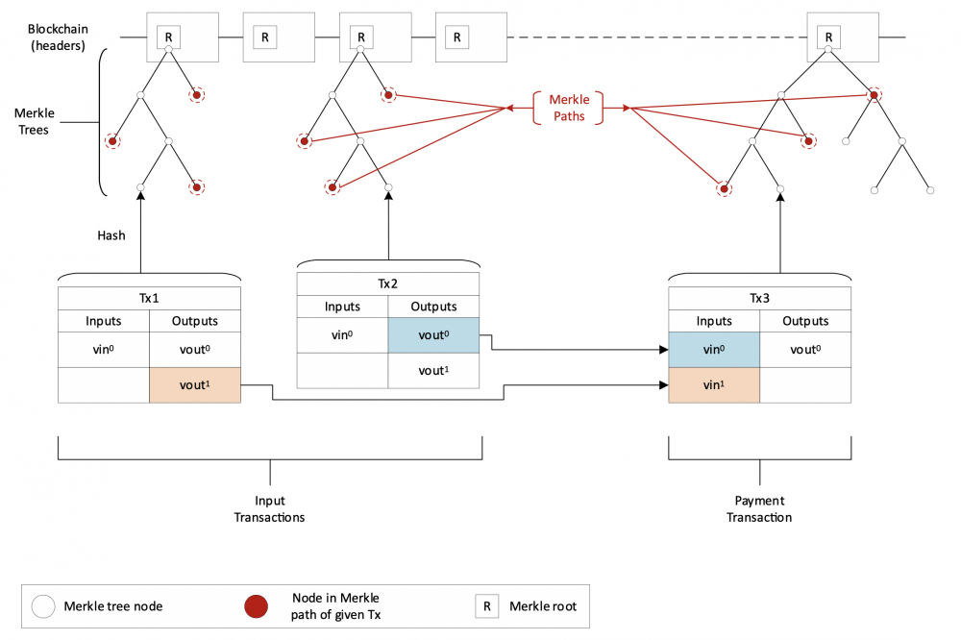
Mart 2019'da Merkle Trees and SPV (Craig Wright, 2019) başlıklı bir makale, SPV ve işlem doğrulaması ile ilgili önceki bazı yanlış anlamaları netleştirdi. Makale, işlem karmalarının bir blok başlığındaki Merkle köküyle nasıl ilişkilendirilebileceğini gösteren yandaki diyagramı içeriyordu.
Bir UTXO harcamak için, bir SPV cüzdan kullanıcısı alıcıya aşağıdaki bilgileri iletecektir:
Tx0 çıktı olarak UTXO'yu içeren işlem,
Merkle yolu Tx0
Merkle yolundan (veya tanımlayıcısından, örneğin blok yüksekliğinden) türetilen Merkle kökünü içeren blok başlığı
Tx1- UTXO'yu harcayan işlem
Bilgiyi doğrulamak için bir kullanıcı, Merkle yolunun Merkle yolunu hesaplar. . Kullanıcı daha sonra bunu blok başlığında belirtilen Merkle kökü ile karşılaştırır. Aynı ise, kullanıcı bunu kabul eder. zincir içindedir.

Slide 8
Cüzdanlar

Slide 9
WHAT ARE WALLETS?
Bitcoin Wallets
Kimliğimizi gizlemek için, we özel anahtarımızı (private key) korumamız gerekiyor
Tüm anahtarlarımızı nasıl yönetiriz? Cüzdanlarla!
ADDRESS: 1JJQmRbU9JT9mfxjp756YMuxV6yksKtbk5
PRIVATE_KEY: L1fm3iAFdDHwSD3CZuZmWp54GXpQ6QzUjmrACVfKKE8BkggW99u3
AUTHOR: NADIR AKHTAR

Slide 10

WHAT ARE WALLETS?
Bitcoin Cüzdanları
Cüzdanlar ne yapar?
Blok zincirine bir kullanıcı arayüzü sağlar
Özel anahtarınızı takip etmeyi sağlar
İşlemleri depolama, gönderme, alma ve listeleme
Belki başka ilginç işlevler
AUTHOR: SUNNY AGGARWAL & RUSTIE LIN
UPDATED: JUSTIN YU

Slide 11
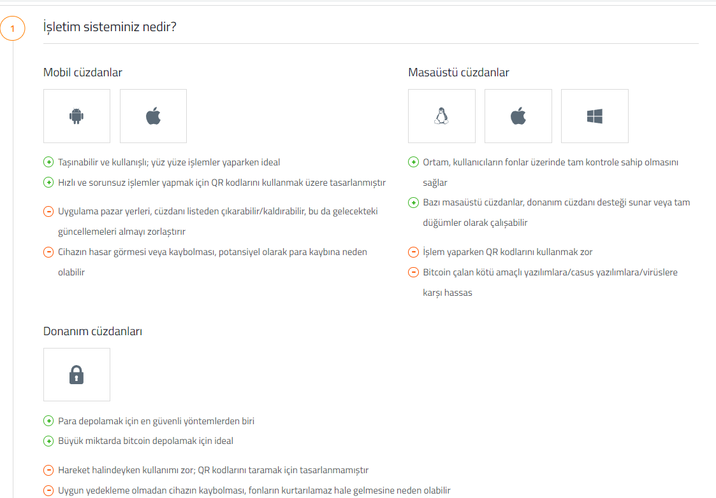
WHAT ARE WALLETS?
Cüzdan Tipleri
https://bitcoin.org/en/choose-your-wallet

Slide 12



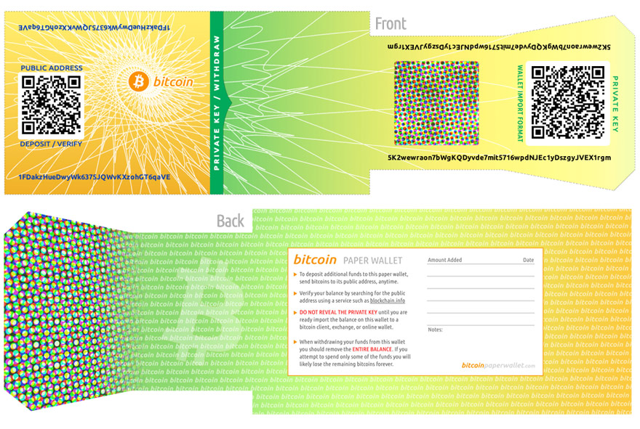
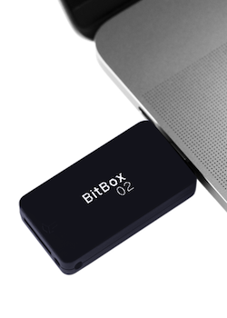


WHAT ARE WALLETS?
Sıcak vs. Soğuk Cüzdanlar
Bitcoin Cüzdanları
Sıcak
Soğuk
Mobil Uygulamalar
PC Cüzdanlar
Kağıt Cüzdanlar
Donanımsal
Beyin
AUTHOR: SUNNY AGGARWAL & RUSTIE LIN
UPDATED: NADIR AKHTAR & HAENA LEE

Slide 13
WHAT ARE WALLETS?
Sıcak Cüzdanlar
Bitcoin Cüzdanları
Sıcak
Soğuk
Mobil Uygulamalar
PC Cüzdanlar
Kağıt Cüzdanlar
Donanımsal
Beyin
AUTHOR: SUNNY AGGARWAL & RUSTIE LIN
UPDATED: NADIR AKHTAR & HAENA LEE

Slide 14
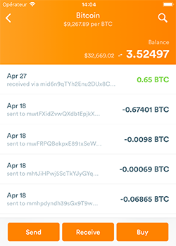
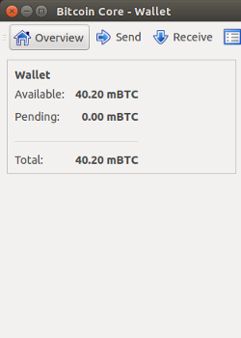

WHAT ARE WALLETS?
Sıcak Cüzdanlar
AUTHOR: SEHYUN CHUNG
Image sources:
bitcoin.org

Slide 15
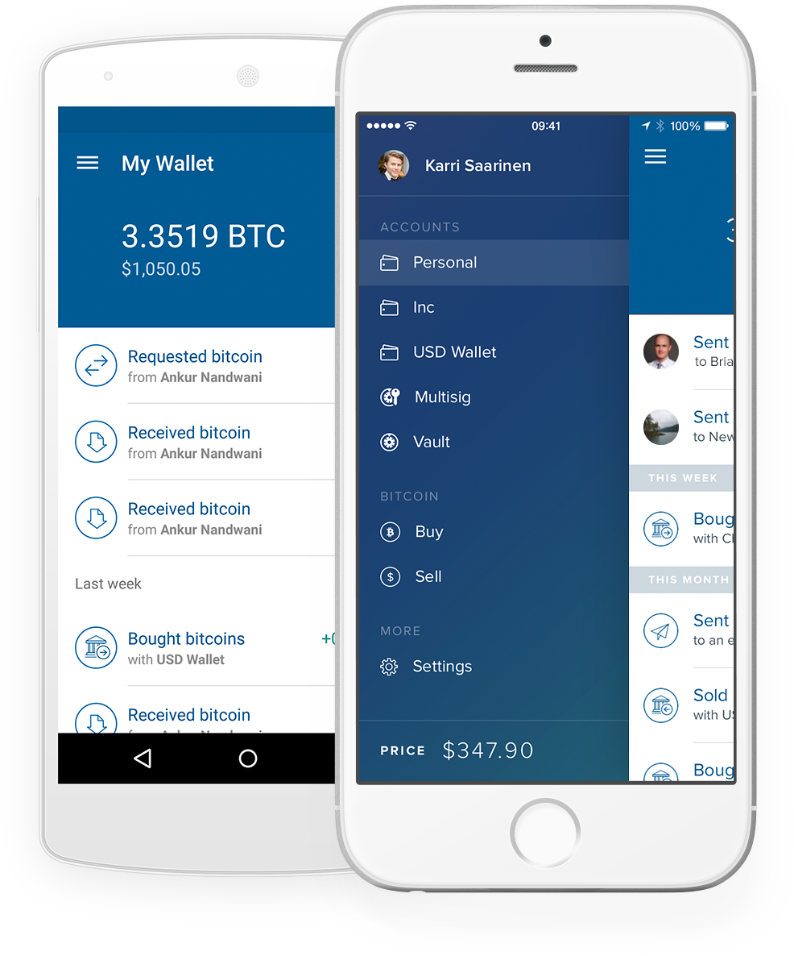



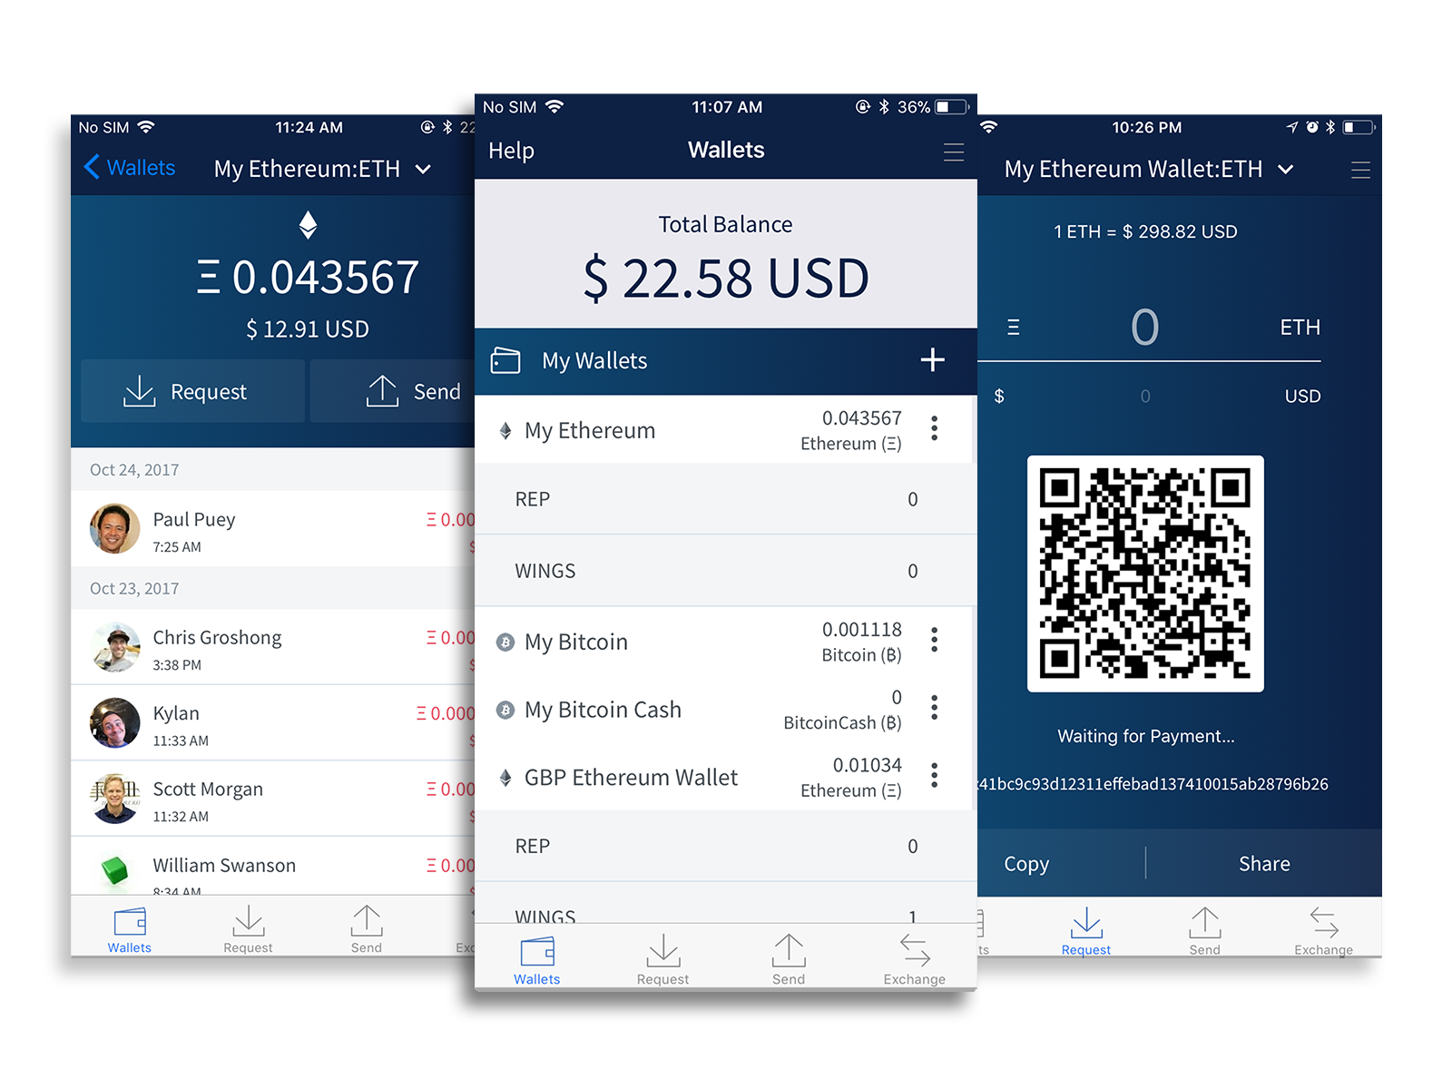
HOT WALLETS
BITCOIN CÜZDANLARI
Image sources:
https://blockchain.info/
https://wallet.mycelium.com
https://airbitz.co/bitcoin-wallet/
https://www.coinbase.com/mobile
mycelium

Slide 16
WHAT ARE WALLETS?
Soğuk Cüzdanlar
Bitcoin Cüzdanları
Sıcak
Soğuk
Mobil Uygulamalar
PC Cüzdanlar
Kağıt Cüzdanlar
Donanımsal
Beyin

Slide 17
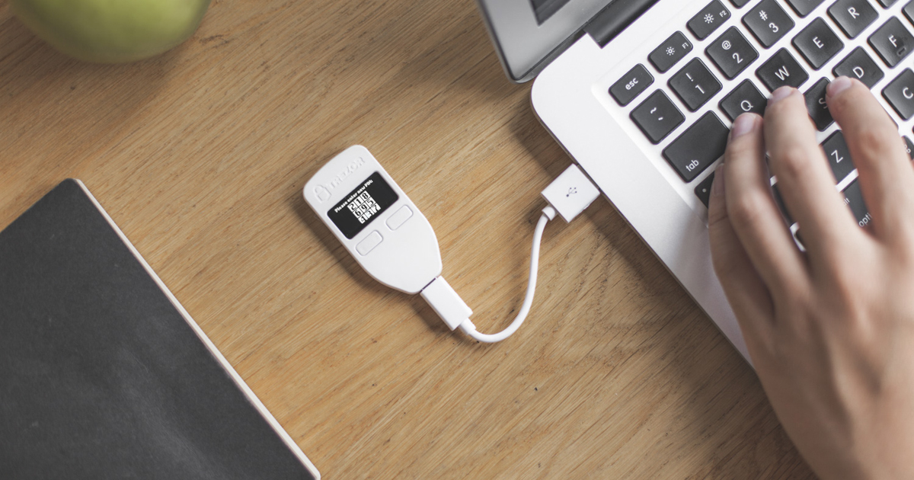
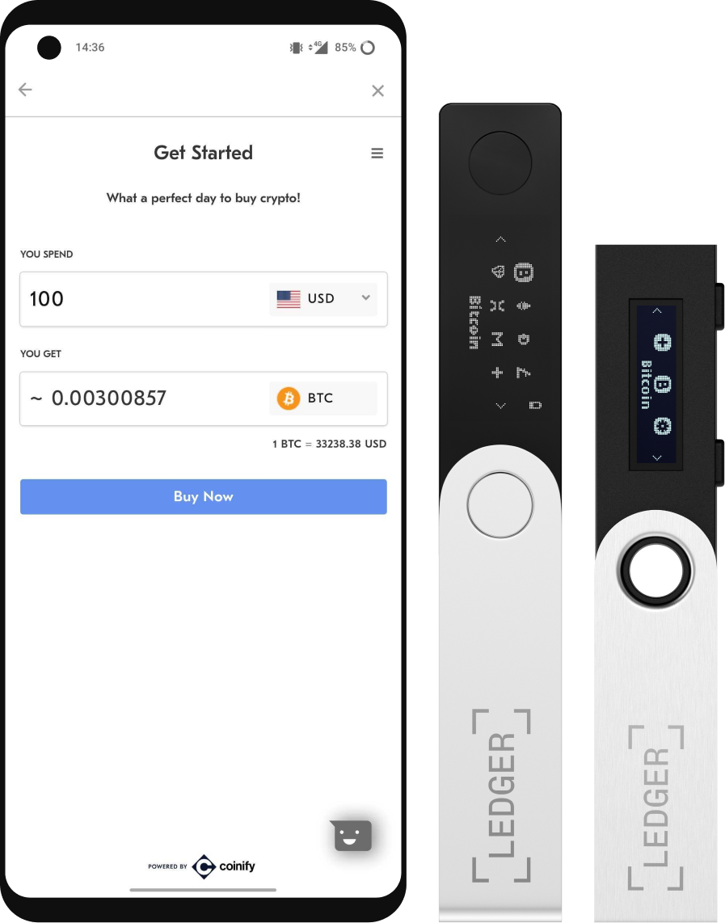
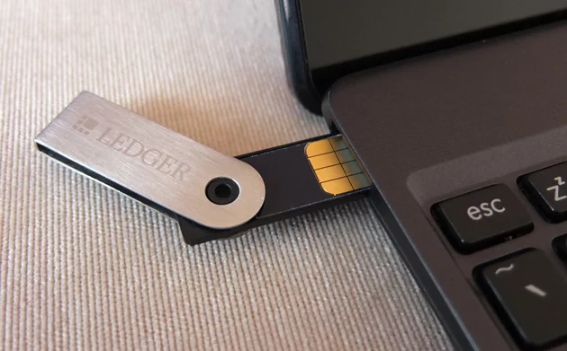
WHAT ARE WALLETS?
Donanımsal Cüzdanlar
Donanım cüzdanınız yalnızca özel anahtarlarınızı saklar ve korur.
AUTHOR: RUSTIE LIN
UPDATED BY: SEHYUN CHUNG
Image sources:
https://www.ledgerwallet.com/
https://trezor.io/
https://bitcoin.org/

Slide 18
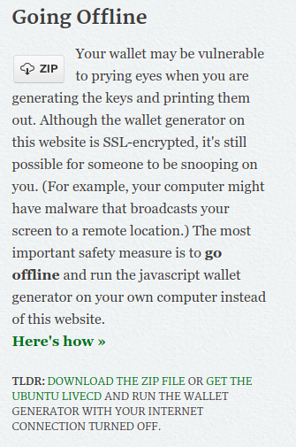
WHAT ARE WALLETS?
Kağıt Cüzdanlar
AUTHOR: RUSTIE LIN
Image source: https://bitcoinpaperwallet.com/

Slide 19
BRAIN WALLETS
BITCOIN CÜZDANLARI
L2Skyj3pJK3nc7wgr9afokGL89dPWV3iHQJvZiy2zEwvXDQReAgg
Özel anahtarınızı ezberleyin
AUTHOR: BRIAN HO
UPDATED: HAENA LEE

Slide 20
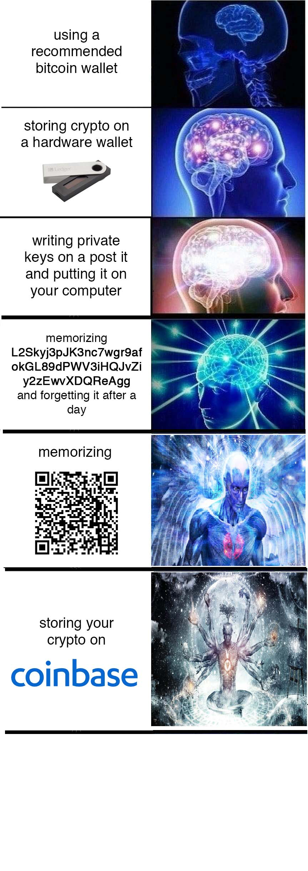

Slide 23
BRAIN WALLETS
BITCOIN CÜZDANLARI
L2Skyj3pJK3nc7wgr9afokGL89dPWV3iHQJvZiy2zEwvXDQReAgg
Özel anahtarınızı ezberleyin
AUTHOR: BRIAN HO
UPDATED: HAENA LEE

Slide 24
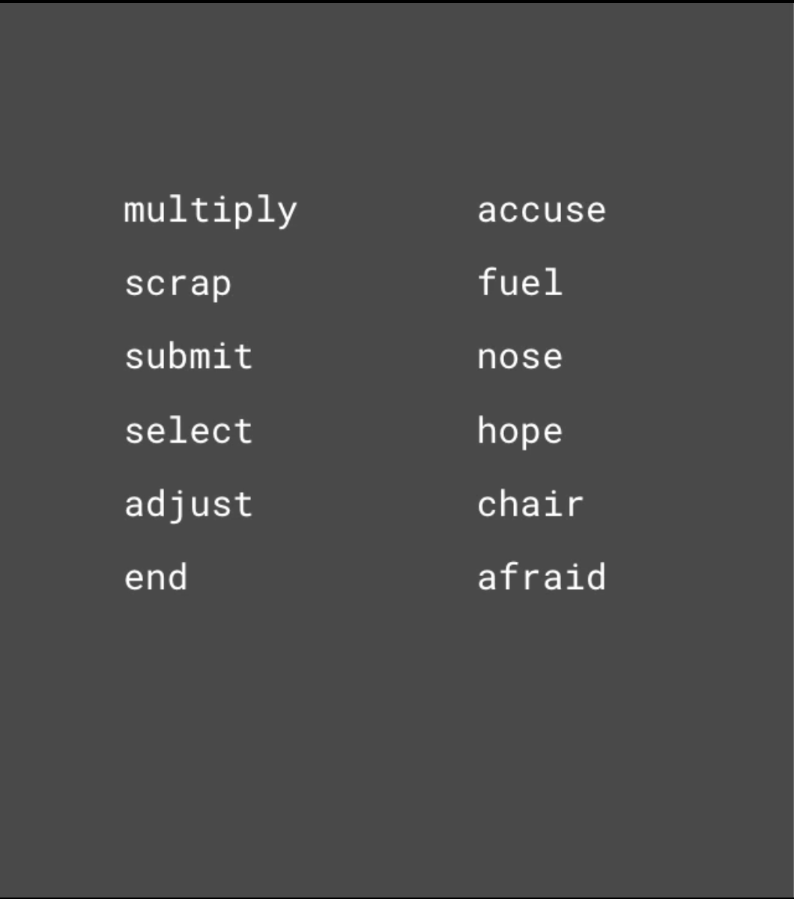
WHAT ARE WALLETS?
Beyin Cüzdanları
Beyin cüzdanları bir anımsatıcı veya kelime/ifade koleksiyonudur.
Özel anahtarınızı ezberlemenin kolay yolu
Özel anahtarınıza dönüştürebileceğiniz bir şeye sahip olmak daha kolay
İnsanlar sandığımız kadar rastgele olmadığı için pek güvenli değil
AUTHOR: SUNNY AGGARWAL & RUSTIE LIN
UPDATED: HAENA LEE

Slide 25
WHAT ARE WALLETS?
Beyin Cüzdanları
multiply accuse
scrap fuel
submit nose
select hope
adjust chair
end afraid
multiply accuse
scrap fuel
submit nose
select hope
adjust chair
end afraid
L2Skyj3pJK3nc7wgr9afokGL89dPWV3iHQJvZiy2zEwvXDQReAgg
AUTHOR: SUNNY AGGARWAL & RUSTIE LIN
UPDATED: HAENA LEE

Slide 26
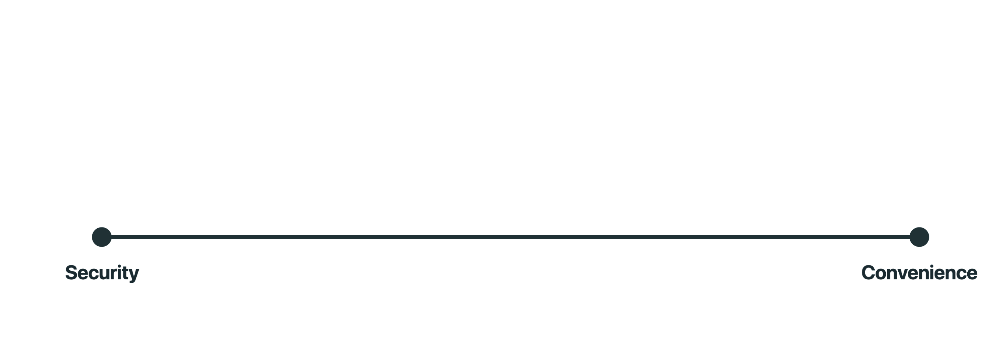
WHAT ARE WALLETS?
Farklılıklar
AUTHOR: SEHYUN CHUNG

Slide 27
KEY STRETCHING
BITCOIN WALLETS
Key Stretching, bir şeyi tekrar tekrar hash ederek belirli bir hash'e ulaşmak için gereken süreyi arttırdığımız bir yöntemdir.
Saldırıyı gerçekleştirmenin daha uzun sürmesini sağlayarak Sözlük Saldırılarını caydırır
SHA-256
AUTHOR: SUNNY AGGARWAL

Slide 28
WALLET TYPES
Tartışma
Çevrimiçi sıcak cüzdan ve çevrimdışı soğuk depolama cüzdanı kullanma arasındaki bazı ödünler nelerdir?
AUTHOR: RUSTIE LIN

Slide 29
Bitcoin Almak

Slide 30

????????????
NASIL BITCOIN ALABİLİRİM?
“Ama nasıl bitcoin alabilirim?”
AUTHOR: RUSTIE LIN
Image source: https://www.reddit.com/r/Bitcoin/

Slide 31
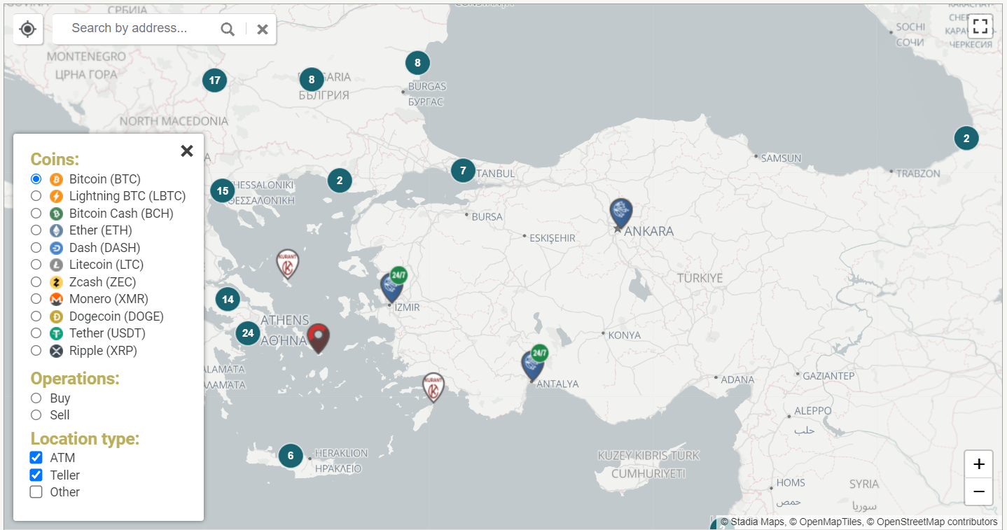
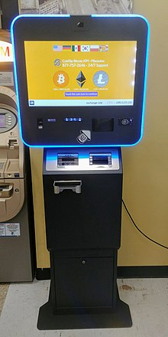
Bitcoin ATM’leri
29 Ekim 2013'te Kanada, Vancouver: Robocoin ATM
Peoria, Illinois'deki kripto para ATM'si. Bu model "iki yönlüdür", yani kullanıcılar Bitcoin ve diğer kripto para birimlerini alıp satabilir.
Image sources:
https://coinatmradar.com/
AUTHOR: RUSTIE LIN

Slide 32
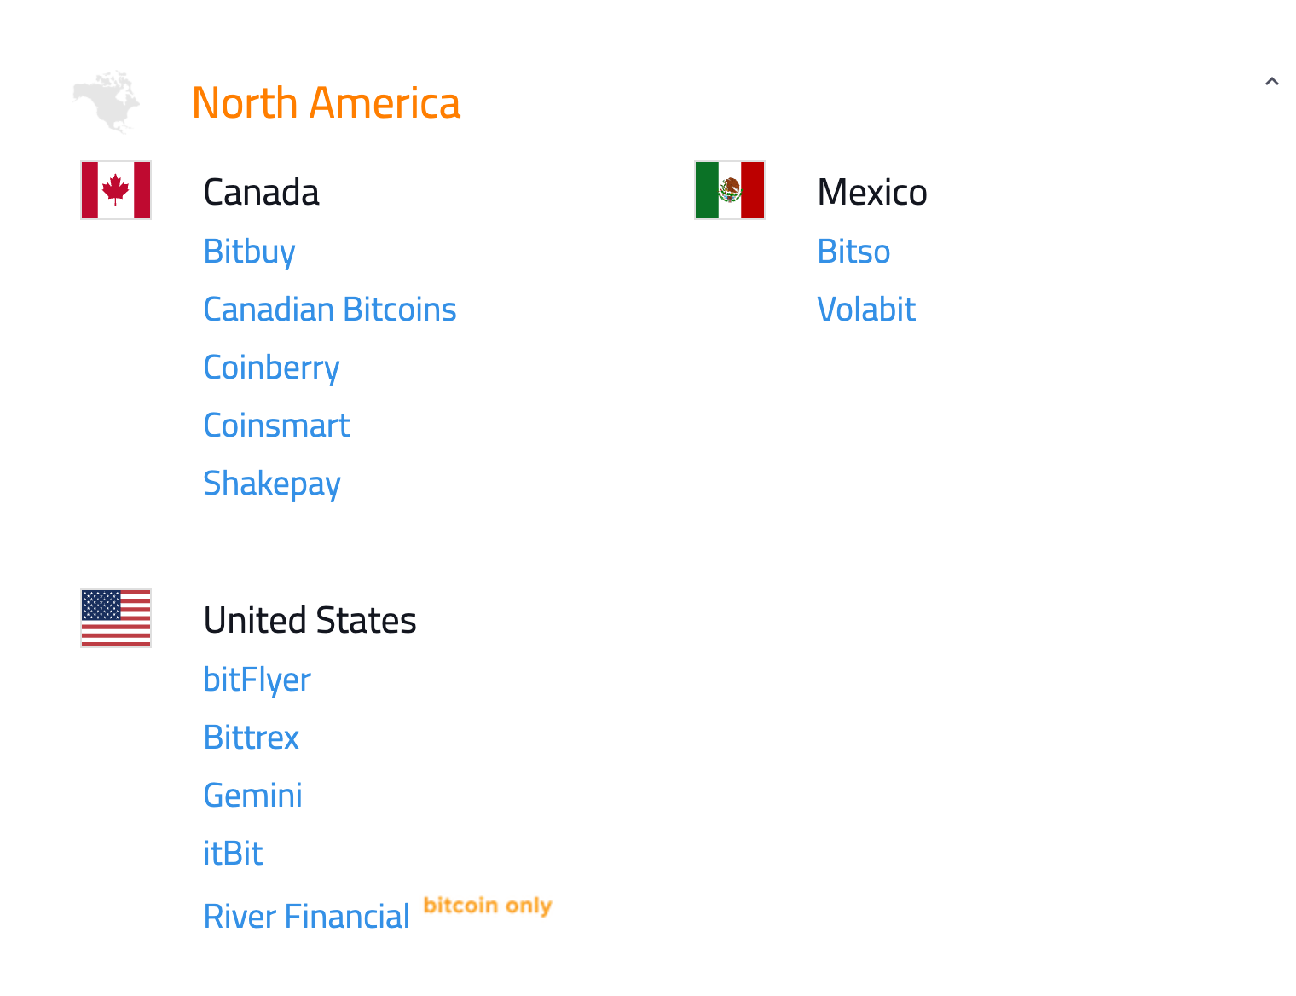

ACQUIRING BITCOIN
Merkezi Borsalar
Borsalar:
https://bitcoin.org/en/exchanges
Farklı para birimleri arasında ticaret
Merkezi ve merkezi olmayan borsalar, güvenlik, erişim kolaylığı vb.
AUTHOR: RUSTIE LIN
Image source: https://bitcoin.org/en/exchanges

Slide 33
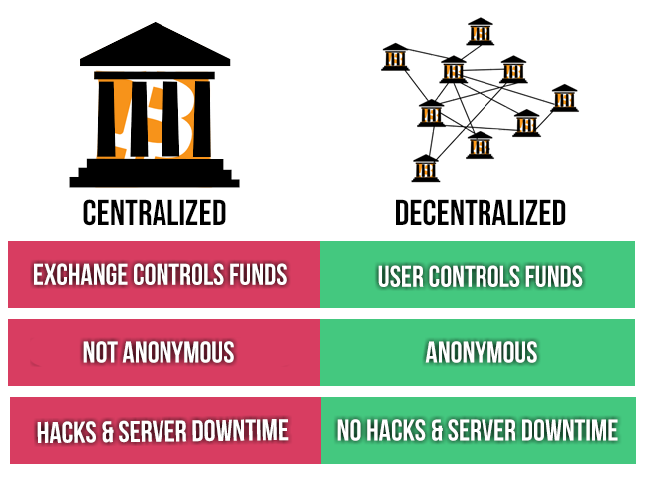

ACQUIRING BITCOIN
Merkezi Olmayan Borsalar (DEXs)
Merkezi olmayan borsalar, müşterinin fonlarını veya özel anahtarlarını tutmak için bir üçüncü taraf hizmetine güvenmez
İşlemler P2P
Güvensiz
Bisq, Uniswap, BitQuick
Image source: https://medium.com/@velareum/centralized-vs-decentralized-p2p-exchange-5081a095bd5c
AUTHOR: RUSTIE LIN

Slide 34


ACQUIRING BITCOIN
Different Types?
🦄
Decentralized Exchanges
Centralized Exchanges
AUTHOR: SEHYUN CHUNG

Slide 35
Bir Cüzdan Oluşturmak

Slide 36
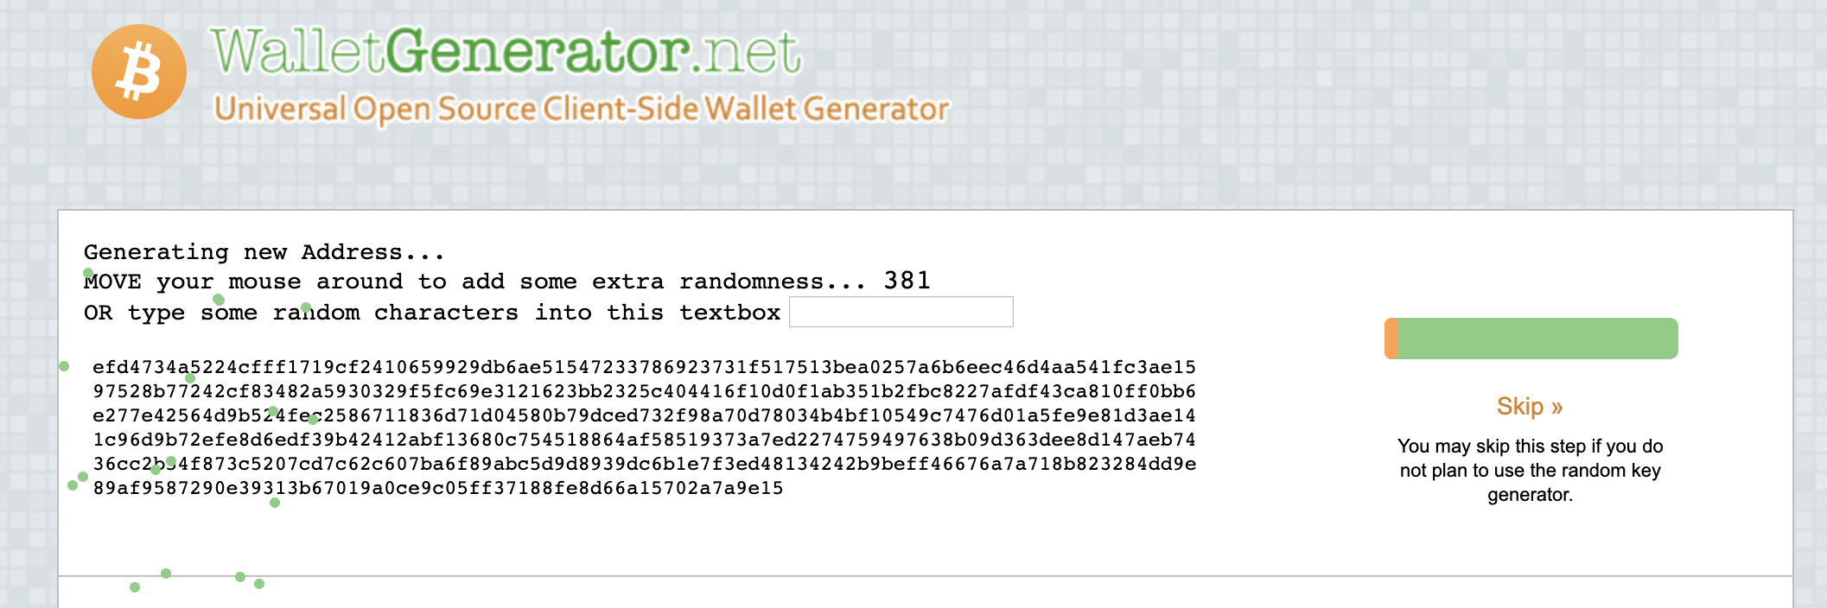
Create a paper/hardware wallet (Metamask flags it as sketch?):
https://walletgenerator.net/

Slide 37
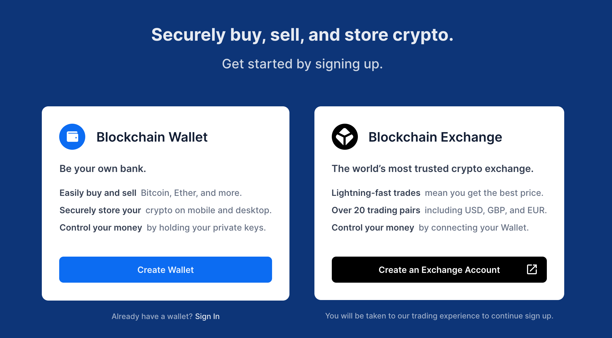
Create a digital wallet:
https://login.blockchain.com/#/signup
Or search for one online (make sure you can trust it! This is one of the downsides of an online wallet.)

Slide 38
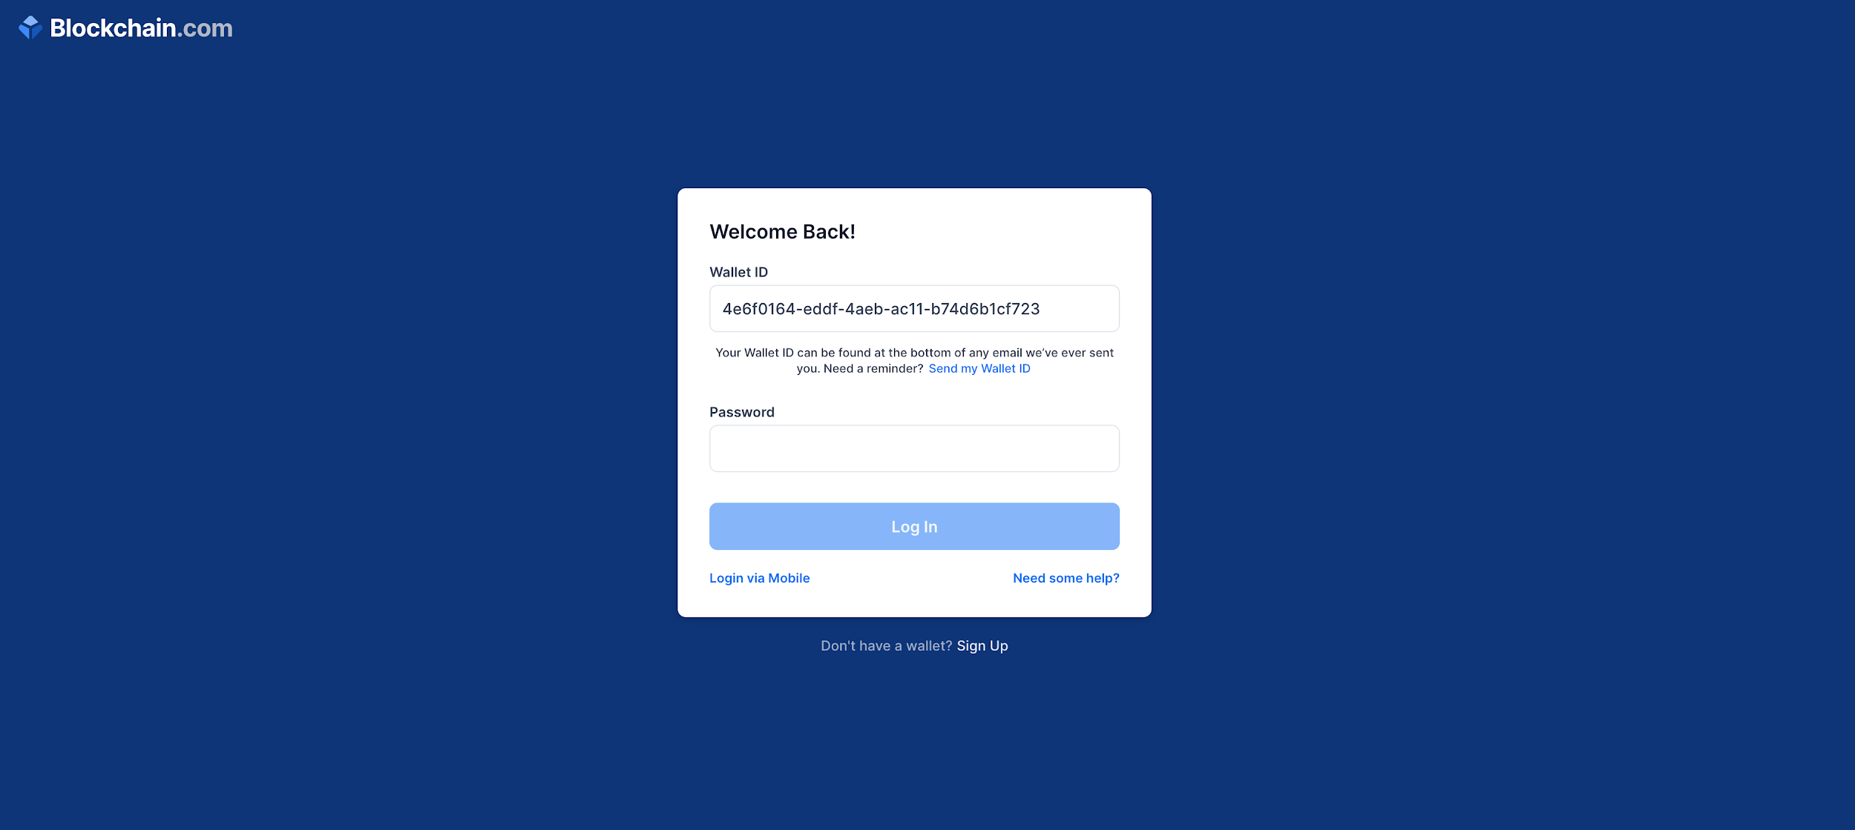

Slide 39
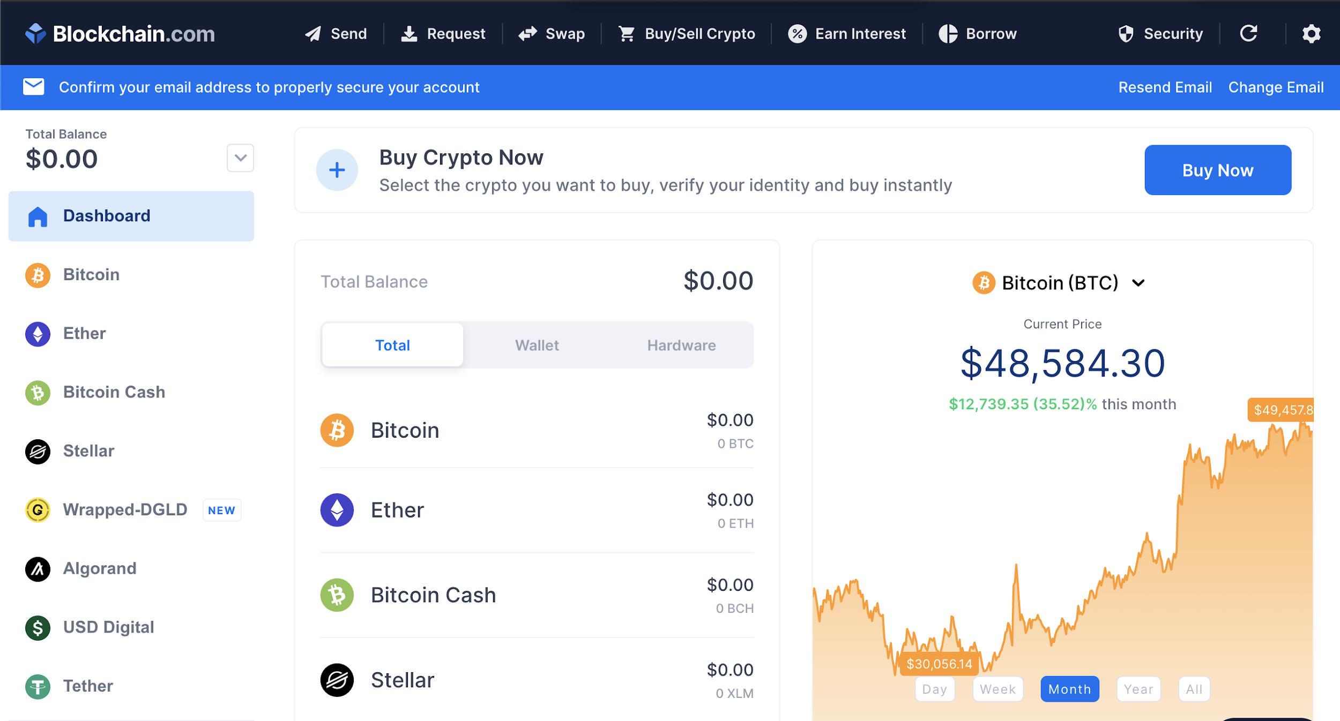
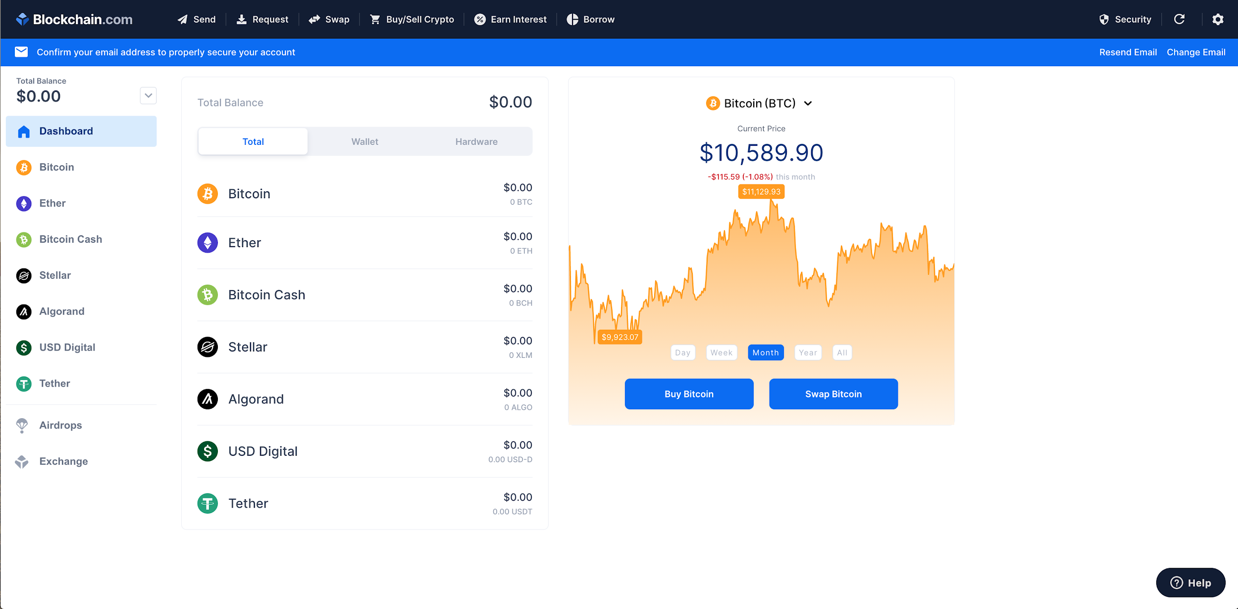

Slide 40
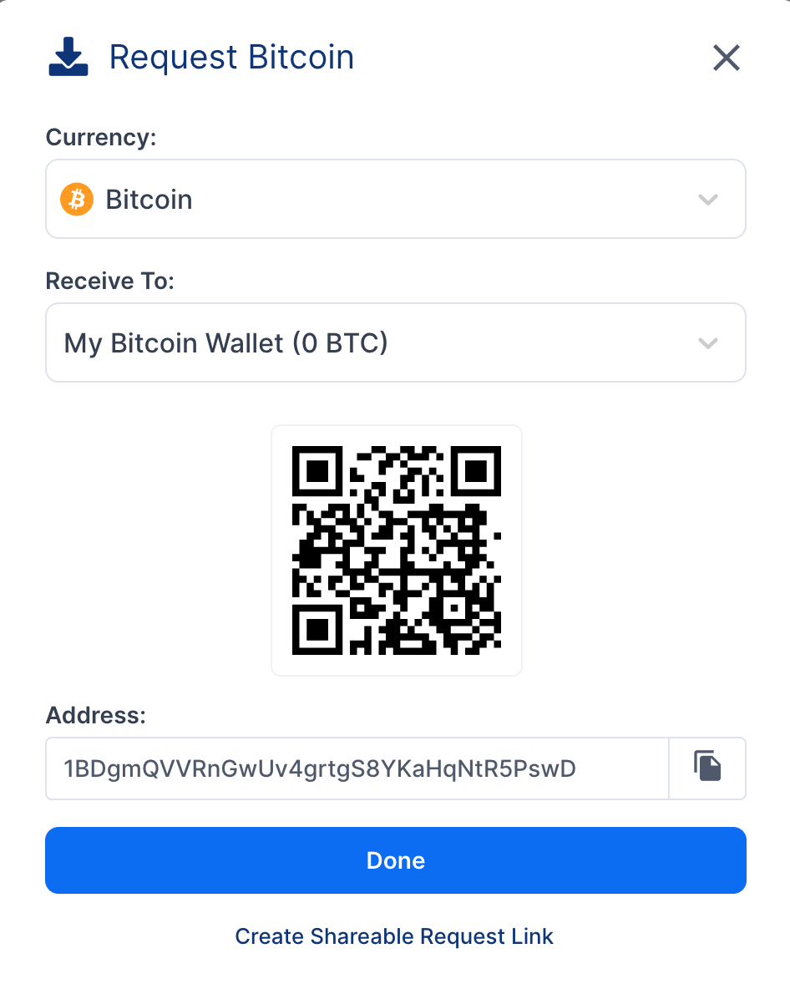
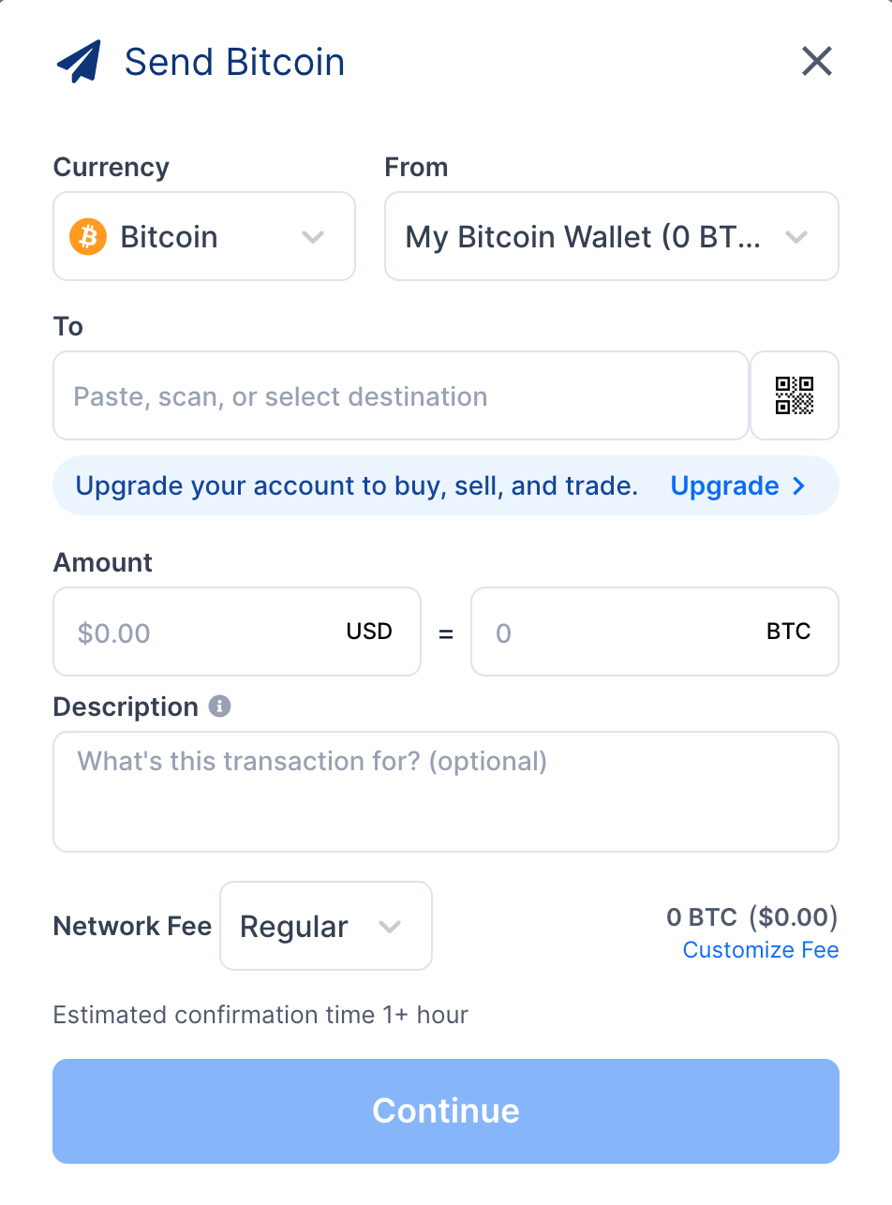
Send and receive BTC

Slide 41
Cüzdan Mekanizması

Slide 42
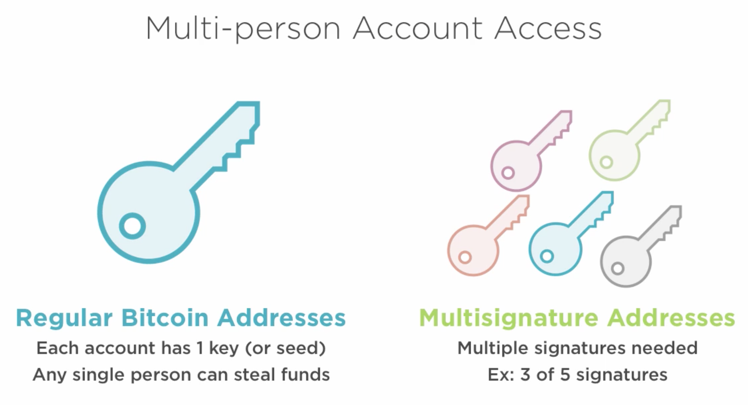
WALLET MECHANICS
Multisig
AUTHOR: SUNNY AGGARWAL

Slide 43


WALLET MECHANICS
Multisig
Justin
Janice
Oscar
Rustie
AUTHOR: RUSTIE LIN

Slide 44
WALLET MECHANICS
Best Practices
En iyi uygulama, takma adları, genel anahtarları asla yeniden kullanmamaktır
Why?
Birisi ne kadar bitcoin sahibi olduğunuzu belirleyememeli
Anahtarların oluşturulması zaten hesaplama açısından kolaydır
Cüzdan yazılımı bunu halleder
AUTHOR: SUNNY AGGARWAL

Slide 45
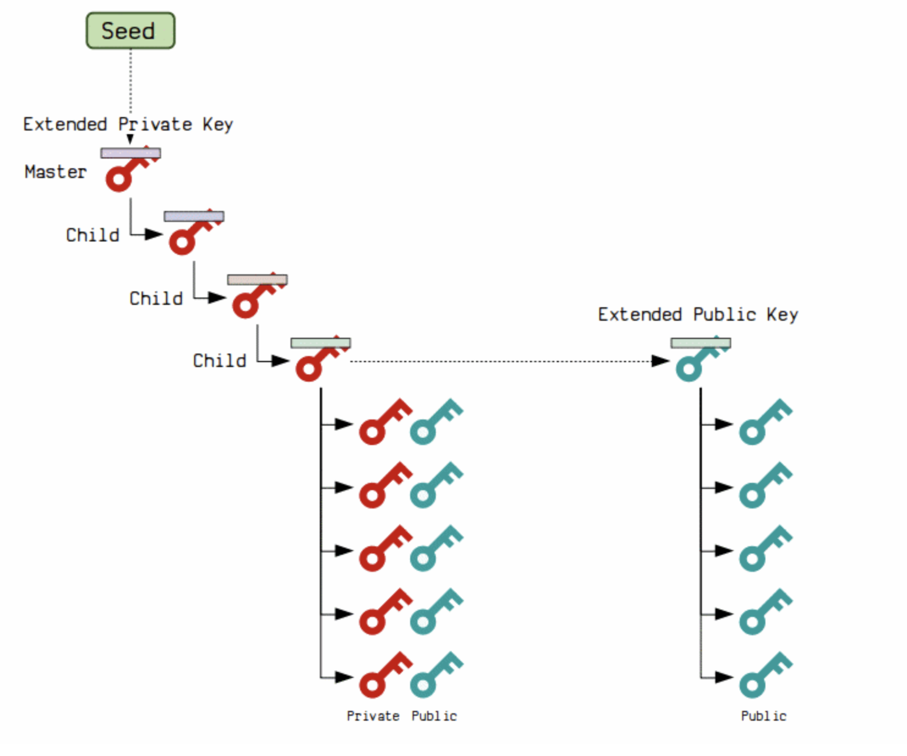
WALLET MECHANICS
Hiyerarşik Deterministik (HD) Cüzdanlar
Deterministik çünkü tüm alt anahtarlar her seferinde aynı şekilde bir tohumdan üretilir
Hiyerarşiktir, çünkü anahtarları seviyelerle ağaç benzeri bir yapıda düzenleyebilirsiniz.
AUTHOR: RUSTIE LIN
UPDATED BY: SEHYUN CHUNG

Slide 46
WALLET MECHANICS
Hiyerarşik Deterministik (HD) Cüzdanlar
Daha az hata noktası: bir ana özel anahtarı depolayın/yedekleyin, ardından tüm alt anahtar ağacını türetin (ayrıca bir kusur olarak kabul edilebilir)
Erişim kontrolü: ağaç benzeri yapı, sahibine belirli bir şube atayarak, birisinin cüzdanın yalnızca bir kısmına erişmesine izin vermesini sağlar.
AUTHOR: SEHYUN CHUNG

Slide 47
WALLET MECHANICS
HD Wallets
Start with a master private key
Generate child private keys by hashing your private key + index
Use the public key of the master private key to generate child public keys
By the nature of hash functions (same input always means same output), we only need the master key
AUTHOR: SEHYUN CHUNG

Slide 48
MULTISIG TRANSACTION
BITCOIN MECHANICS
Justin
Justin
Justin
Rustie
AUTHOR: RUSTIE LIN

Slide 49
MULTISIG TRANSACTION
BITCOIN MECHANICS
Company
Justin
Gillain
Rustie
AUTHOR: RUSTIE LIN

Slide 50
JBOK WALLETS
WALLET BACKUPS
JBOK (Just a Bunch Of Keys)
New backup required for every new key pair
Or, generate a bunch of keys when first started
Not too convenient because you have to store every key pair
AUTHOR: RUSTIE LIN

Slide 52
Mining

Slide 53
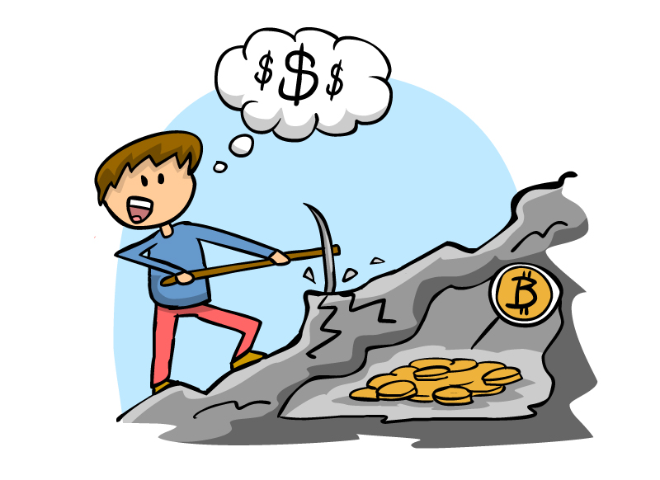
OVERVIEW
RECIPE FOR MINING
A full-fledged Bitcoin miner must:
Download the entire Bitcoin blockchain
Verify incoming transactions
Create a block
Find a valid nonce
Broadcast your block
Profit!
Image source: http://www.coindesk.com/information/how-to-set-up-a-miner/
AUTHOR: NADIR AKHTAR
U[DATED: RUSTIE LIN

Slide 54
STEP 1: DOWNLOAD THE BLOCKCHAIN
RECIPE FOR MINING
Sehyun
Andrew
Get blocks from your peers
Download the entire blockchain
Start from the genesis block
Stay up to date
Diego
Janice
Erika
BLOCK HEADER
BLOCK HEADER
BLOCK HEADER
PREV BLOCK HASH
MERKLE ROOT
PREV BLOCK HASH
MERKLE ROOT
PREV BLOCK HASH
MERKLE ROOT
AUTHOR: RUSTIE LIN

Slide 55
Sehyun
Andrew
Diego
Janice
Erika

Slide 56


STEP 2: VERIFY TRANSACTIONS
RECIPE FOR MINING
Listen to the Bitcoin network for transactions
Unconfirmed (pending) transactions sit in the mempool for a miner to include it in a block
Verify incoming transactions
Sehyun
Andrew
Diego
Image sources: https://ru-clip.com/video/rVrb6rrRvNQ/what-is-a-mempool-and-how-to-speed-up-unconfirmed-transactions.html
https://englishinreims.wordpress.com/toeic-training/practice-toeic-listening-part-i/
Janice
Erika
AUTHOR: RUSTIE LIN

Slide 57
STEP 3: CREATE A BLOCK
RECIPE FOR MINING
BLOCK HEADER
BLOCK HEADER
BLOCK HEADER
PREV BLOCK HASH
MERKLE ROOT
PREV BLOCK HASH
MERKLE ROOT
PREV BLOCK HASH
MERKLE ROOT
E = H(A || B)
F = H(C || D)
Gather transactions into a block
Choose whichever transactions you want (most transaction fees)
Get previous block hash and other necessary metadata
A = H(TX₁)
B = H(TX₂)
C = H(TX₃)
D = H(TX₄)
Coinbase
TX₂
TX₃
TX₄
AUTHOR: RUSTIE LIN

Slide 58
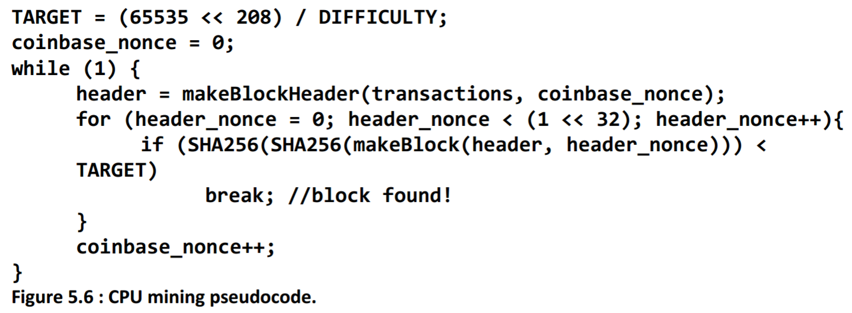
STEP 4: FIND A VALID NONCE
RECIPE FOR MINING
Find the proof-of-work
Expend computational power
Incrementing header nonce first, then coinbase nonce as necessary to change puzzle
BLOCK HEADER
PREV BLOCK HASH
MERKLE ROOT
NONCE
TIMESTAMP
TARGET
VERSION
Image source: Mastering Bitcoin
AUTHOR: RUSTIE LIN

Slide 59
STEP 4: FIND A VALID NONCE
RECIPE FOR MINING: CURRENT TARGET
0000000000000000000cf4e30000000000000000000000000000000000000000
Target source: Learn Me a Bitcoin
AUTHOR: RUSTIE LIN

Slide 60
STEP 5: BROADCAST
RECIPE FOR MINING
Look, I found a new block! Check it out!
Janice
Sehyun
Dang it, you beat me to it...
Diego
Andrew
Erika
AUTHOR: JUSTIN YU

Slide 61

STEP 5: BROADCAST (VALIDATION)
RECIPE FOR MINING
Is the block header < the target?
Janice
Sehyun
Hmm… let me check this.
Diego
How much mining reward is attached?
Andrew
Are all the transactions valid?
Erika
AUTHOR: JUSTIN YU

Slide 62
STEP 5: BROADCAST (CONSENSUS!)
RECIPE FOR MINING
This seems fine to me.
There’s a reason I’m green. 🤑
Janice
Sehyun
There goes all my work...
Diego
Math checks out.
Andrew
No time to waste. Let’s try again...
Erika
AUTHOR: JUSTIN YU

Slide 63
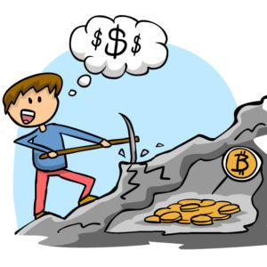
STEP 6: PROFIT
RECIPE FOR MINING
Remember: Mining is a competition
Longest chain rules!
Block included in longest chain
Profit from block reward (coinbase transaction) and transaction fees
All transactions added to canon transaction history
Not included in longest chain
Your block may not have been the first valid block seen by others
Start mining next block
Image source: http://www.coindesk.com/information/how-to-set-up-a-miner/
AUTHOR: RUSTIE LIN

Slide 65
Mining Incentives

Slide 66
WHY DO WE DO THINGS?
MINING INCENTIVES
PROFIT
AUTHOR: NADIR AKHTAR

Slide 67
WHY DO WE DO THINGS?
MINING INCENTIVES
PROFITPROFIT
PROFITPROFIT
PROFIT
PROFITPROFITPR
PROFITPROFIT
PROFIT
PROFIT
PROFIT
PROFIT
PROFIT
PROFIT
AUTHOR: NADIR AKHTAR
BLOCKCHAIN FUNDAMENTALS LECTURE 4

Slide 68
WHAT IS PROFIT?
MINING INCENTIVES
if revenue > cost:
return “$$$$”
PROFIT = REVENUE - COST
AUTHOR: NADIR AKHTAR

Slide 69
HOW TO PROFIT FROM MINING
MINING INCENTIVES
MINING_REVENUE = BLOCK_REWARD + TX_FEES
MINING_COST = FIXED_COSTS + VARIABLE_COSTS
if MINING_REVENUE > MINING_COST:
miner.get_profit()
AUTHOR: NADIR AKHTAR

Slide 70
HOW TO PROFIT FROM MINING
MINING INCENTIVES
MINING_REVENUE = BLOCK_REWARD + TX_FEES
MINING_COST = FIXED_COSTS + VARIABLE_COSTS
if MINING_REVENUE > MINING_COST:
miner.get_profit()
AUTHOR: NADIR AKHTAR

Slide 71
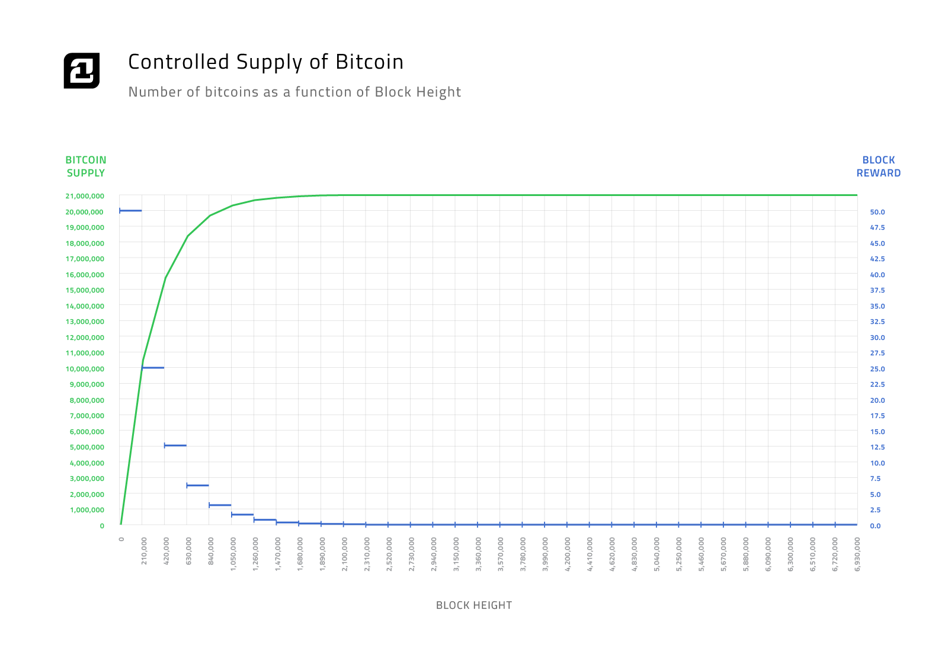
BLOCK REWARD
MINING INCENTIVES
Miner receives BTC for every confirmed block
Currently 6.25 per block
Miner includes special transaction to self
Incentive (profit!) for honest behavior
Halves every 210,000 blocks
Finite # of BTC
BTC supply cap: 21,000,000
AUTHOR: NADIR AKHTAR

Slide 72
BLOCK REWARD: RATIONALE
MINING INCENTIVES
Given:
Profit is primary motivator
Higher incentive for honesty → more secure network
Pseudonymous users → no way to effectively track (or punish) dishonest behavior
Conclusion:
Reward the honest nodes!
Proof-of-Work ensures that miners are dedicated to the network (aka willing to pay money for electricity and hardware just to earn BTC)
AUTHOR: NADIR AKHTAR

Slide 73
HOW TO PROFIT FROM MINING
MINING INCENTIVES
How are miners incentivized to be honest in their mining? Why isn’t it in their best interest to mine empty blocks?
AUTHOR: NADIR AKHTAR

Slide 74
HOW TO PROFIT FROM MINING
MINING INCENTIVES
MINING_REVENUE = BLOCK_REWARD + TX_FEES
MINING_COST = FIXED_COSTS + VARIABLE_COSTS
if MINING_REVENUE > MINING_COST:
miner.get_profit()
AUTHOR: NADIR AKHTAR

Slide 75
HOW TO PROFIT FROM MINING
MINING INCENTIVES
MINING_REVENUE = BLOCK_REWARD + TX_FEES
MINING_COST = FIXED_COSTS + VARIABLE_COSTS
if MINING_REVENUE > MINING_COST:
miner.get_profit()
AUTHOR: NADIR AKHTAR

Slide 76
TRANSACTION FEES
MINING INCENTIVES
Transaction creator sets the fee
Voluntary, but practically necessary
Extra income for miners on top of block reward
Higher transaction fee → faster confirmation time, since more miners want to include your transaction
TX_FEE = INPUT - OUTPUT
When block reward becomes 0, TX fees will become the only source of revenue for miners
Output UTXO
(3 BTC)
Input UTXO
(5 BTC)
Output UTXO
(1 BTC)
...
Transaction Fee
Output UTXO
(0.1 BTC)
0.2 BTC
AUTHOR: NADIR AKHTAR
UPDATED: JUSTIN YU

Slide 77
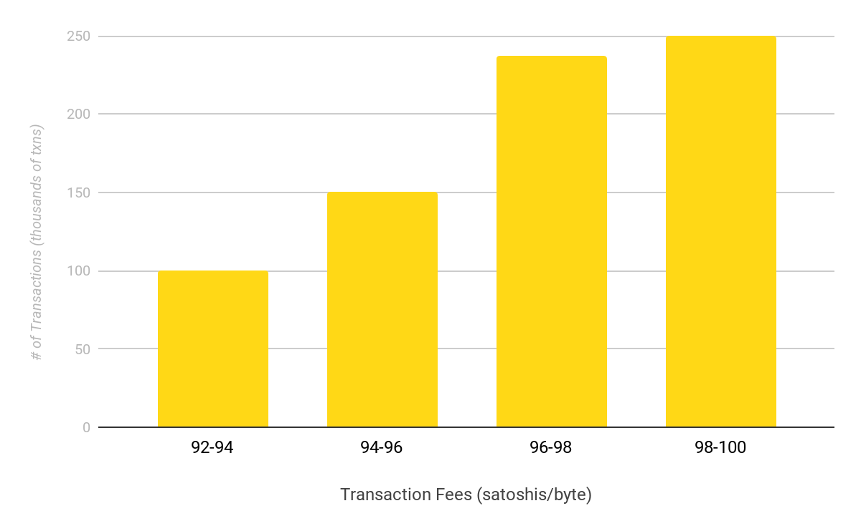
TRANSACTION FEES
FEE ESTIMATION ALGORITHM
Transaction Fee
Input: past transaction data grouped into “buckets”
One bucket represents a range of transaction fees (e.g. 0.00000097 BTC - 0.00000099 BTC)
Identifies the lowest fee rate bucket where all transactions are confirmed
Output: the lowest fee rate bucket. This is the transaction fee you should use to ensure your transaction is put into a block.
Input:
Recent history of txns
Algorithm
0.2 BTC
AUTHOR: SEHYUN CHUNG
SOURCE: MORCOS

Slide 78
TRANSACTION FEES
FEE BUMPING
“bumping” up the transaction of an already broadcast transaction
Why do we need to do this?
transaction can get stuck in the mempool
if the fee associated with a transaction is too low, no miner will want to pick it up
caused by naive fee estimation algorithms, a spike in minimum fees, etc.
AUTHOR: SEHYUN CHUNG

Slide 79
TRANSACTION FEES
FEE BUMPING SOLUTIONS
Replace by Fee (RBF)
the user signs a replacement transaction with the same inputs, but pays additional fees
the additional fee may come from the change output
Child Pays for Parent (CPPP)
the user creates a new transaction which spends one or more of the outputs of the stuck transaction
attaches a large fee
this works because miners package together ancestor and descendant transactions
AUTHOR: SEHYUN CHUNG
SOURCE: JOHN NEWBURY, BITCOINOPS

Slide 81
HOW TO PROFIT FROM MINING
MINING INCENTIVES
MINING_REVENUE = BLOCK_REWARD + TX_FEES
MINING_COST = FIXED_COSTS + VARIABLE_COSTS
if MINING_REVENUE > MINING_COST:
miner.get_profit()
AUTHOR: NADIR AKHTAR

Slide 82
HOW TO PROFIT FROM MINING
MINING INCENTIVES
MINING_REVENUE = BLOCK_REWARD + TX_FEES
MINING_COST = FIXED_COSTS + VARIABLE_COSTS
if MINING_REVENUE > MINING_COST:
miner.get_profit()
AUTHOR: NADIR AKHTAR

Slide 83
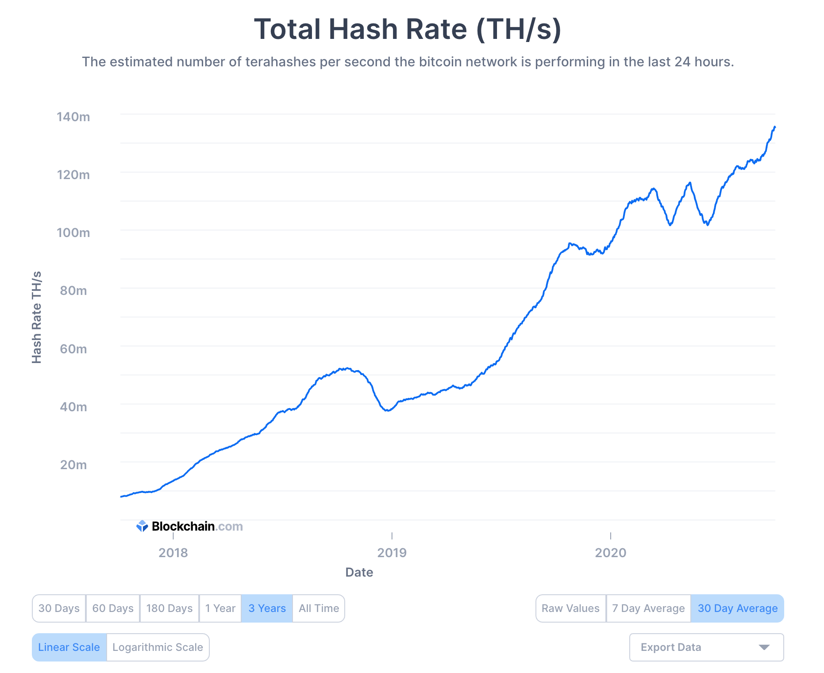
FIXED COST: HARDWARE COSTS
MINING INCENTIVES
 | hashes / second | time to block (years)
CPU | 20 million | 7,620,101
GPU | 200 million | 762,010
FPGA | 1 billion | 152,357
ASIC | 14 trillion | 10.88
AUTHOR: NADIR AKHTAR

Slide 84
FIXED COST: CPU MINING
MINING INCENTIVES
 | hashes / second | time to block (years)
CPU | 20 million | 7,620,101
GPU | 200 million | 762,010
FPGA | 1 billion | 152,357
ASIC | 14 trillion | 10.88
(from Princeton Textbook, 5.2)
Keep in mind that hardware costs are fixed, unlike everything else
AUTHOR: NADIR AKHTAR

Slide 85
FIXED COST: GPU MINING
MINING INCENTIVES
 | hashes / second | time to block (years)
CPU | 20 million | 7,620,101
GPU | 200 million | 762,010
FPGA | 1 billion | 152,357
ASIC | 14 trillion | 10.88
Order of magnitude faster than CPUs
Larger consumption of energy and higher production of heat
Most common in 2012
Disadvantages:
Many components (floating point units) not applicable to mining
Not meant to be run in “farms” side by side
AUTHOR: NADIR AKHTAR

Slide 86
FIXED COST: FPGA MINING
MINING INCENTIVES
 | hashes / second | time to block (years)
CPU | 20 million | 7,620,101
GPU | 200 million | 762,010
FPGA | 1 billion | 152,357
ASIC | 14 trillion | 10.88
Field Programmable Gate Arrays
Developing Bitcoin-specific hardware without losing all customizability
Trade-off between dedicated SHA-256 and general purpose hardware
If Bitcoin fails, SHA-256 specific hardware is worthless
But if Bitcoin thrives, specialized hardware generates higher PROFIT!
AUTHOR: NADIR AKHTAR

Slide 87
FIXED COST: ASIC MINING
MINING INCENTIVES
 | hashes / second | time to block (years)
CPU | 20 million | 7,620,101
GPU | 200 million | 762,010
FPGA | 1 billion | 152,357
ASIC | 14 trillion | 10.88
Application-Specific Integrated Circuit
Does nothing but SHA-256 -- but does it better than anything else
Huge variety with various tradeoffs
Lower base cost vs. lower electricity usage
Compact device vs higher hashrate
Antminer S9 (53 TH/s): $1500
AUTHOR: NADIR AKHTAR

Slide 88
HOW TO PROFIT FROM MINING
MINING INCENTIVES
MINING_REVENUE = BLOCK_REWARD + TX_FEES
MINING_COST = FIXED_COSTS + VARIABLE_COSTS
if MINING_REVENUE > MINING_COST:
miner.get_profit()
AUTHOR: NADIR AKHTAR

Slide 89
HOW TO PROFIT FROM MINING
MINING INCENTIVES
MINING_REVENUE = BLOCK_REWARD + TX_FEES
MINING_COST = FIXED_COSTS + VARIABLE_COSTS
if MINING_REVENUE > MINING_COST:
miner.get_profit()
AUTHOR: NADIR AKHTAR

Slide 90
OPERATING COSTS
MINING INCENTIVES
Energy consumed in mining:
Embodied energy, to produce your hardware
Electricity, to power your hardware
Cooling, to maintain your hardware
Infrastructure
Warehouses
Personnel
All energy converted to heat -- is this not wasteful?
The “data furnace” approach: using mining equipment to generate heat
Unless a high percentage of the network stops mining during the heat, leading to miners dropping out for days on end, or even a whole summer!
AUTHOR: MAX FANG

Slide 91
HOW TO PROFIT FROM MINING
MINING INCENTIVES
MINING_REVENUE = BLOCK_REWARD + TX_FEES
MINING_COST = FIXED_COSTS + VARIABLE_COSTS
if MINING_REVENUE > MINING_COST:
miner.get_profit()
AUTHOR: NADIR AKHTAR

Slide 93
Real Word Mining

Slide 94
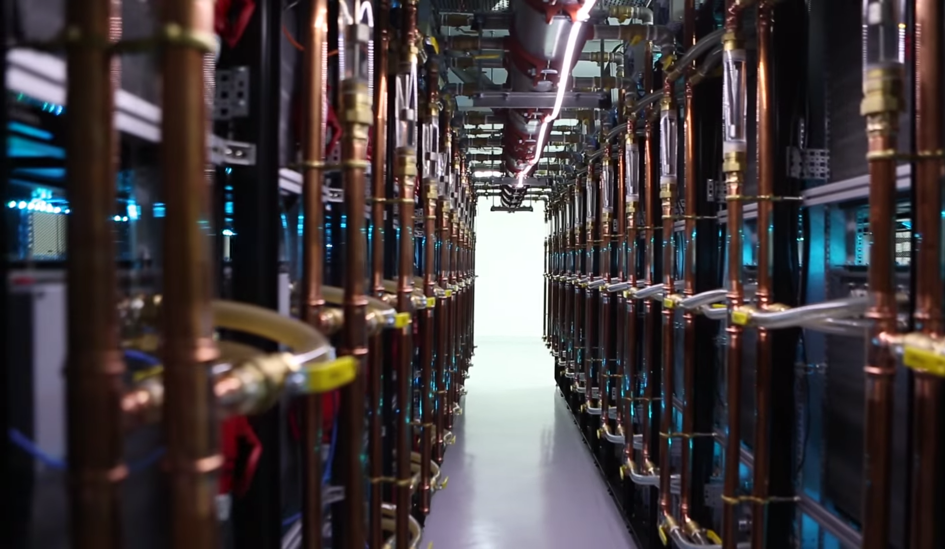
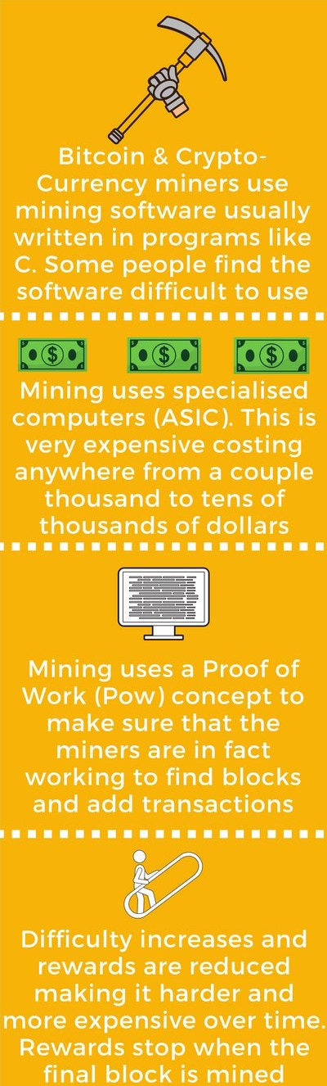
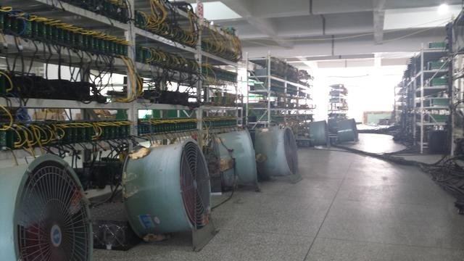
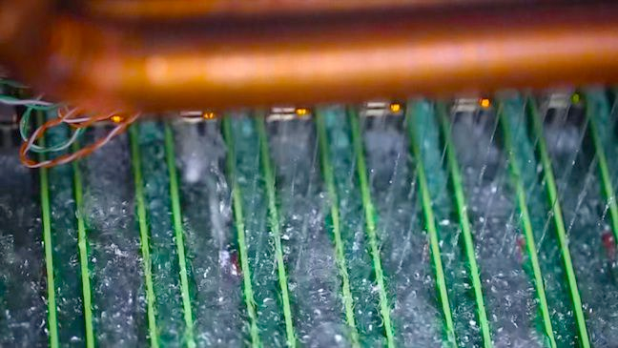
CHINESE ASIC MINING FARM
REAL WORLD MINING
Source: https://www.theregister.co.uk/2014/08/12/chinese_bitcoin_farms_from_scifi_to_scuzzy/
AUTHOR: ERIKA BADALYAN

Slide 95
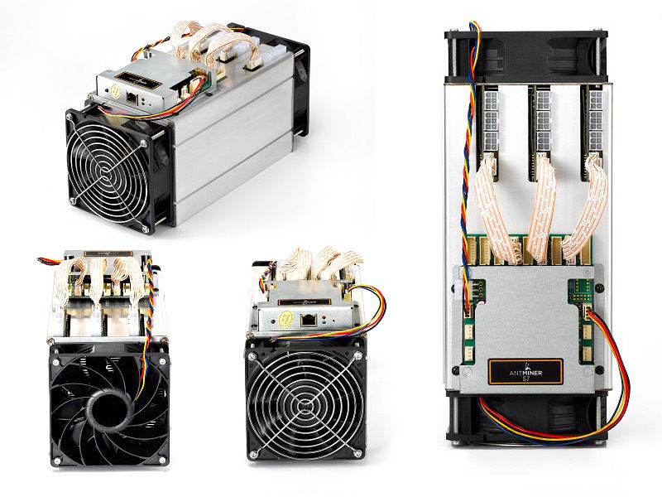
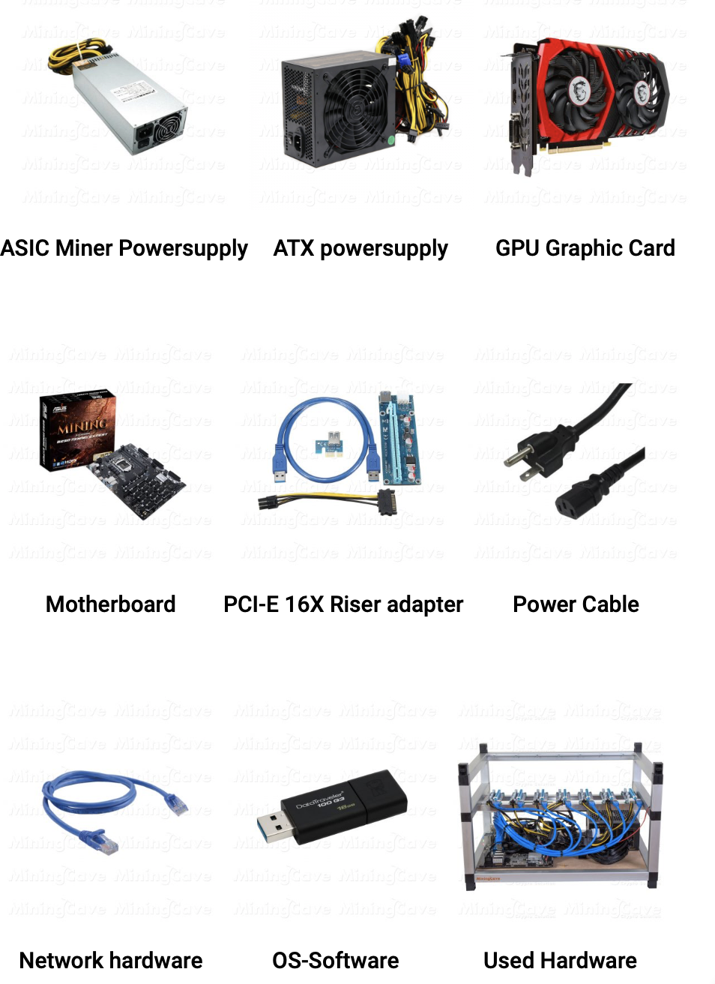
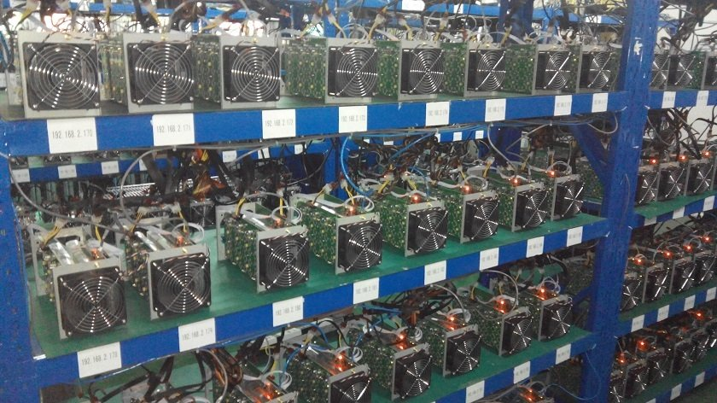
ASICS
REAL WORLD MINING
Source: https://sc01.alicdn.com/kf/HTB18YN_JFXXXXcgXFXXq6xXFXXXw/221223714/HTB18YN_JFXXXXcgXFXXq6xXFXXXw.jpg
Source: https://mybtcpool.com/product/datacenter-hosting/
AUTHOR ERIKA BADALYAN

Slide 96
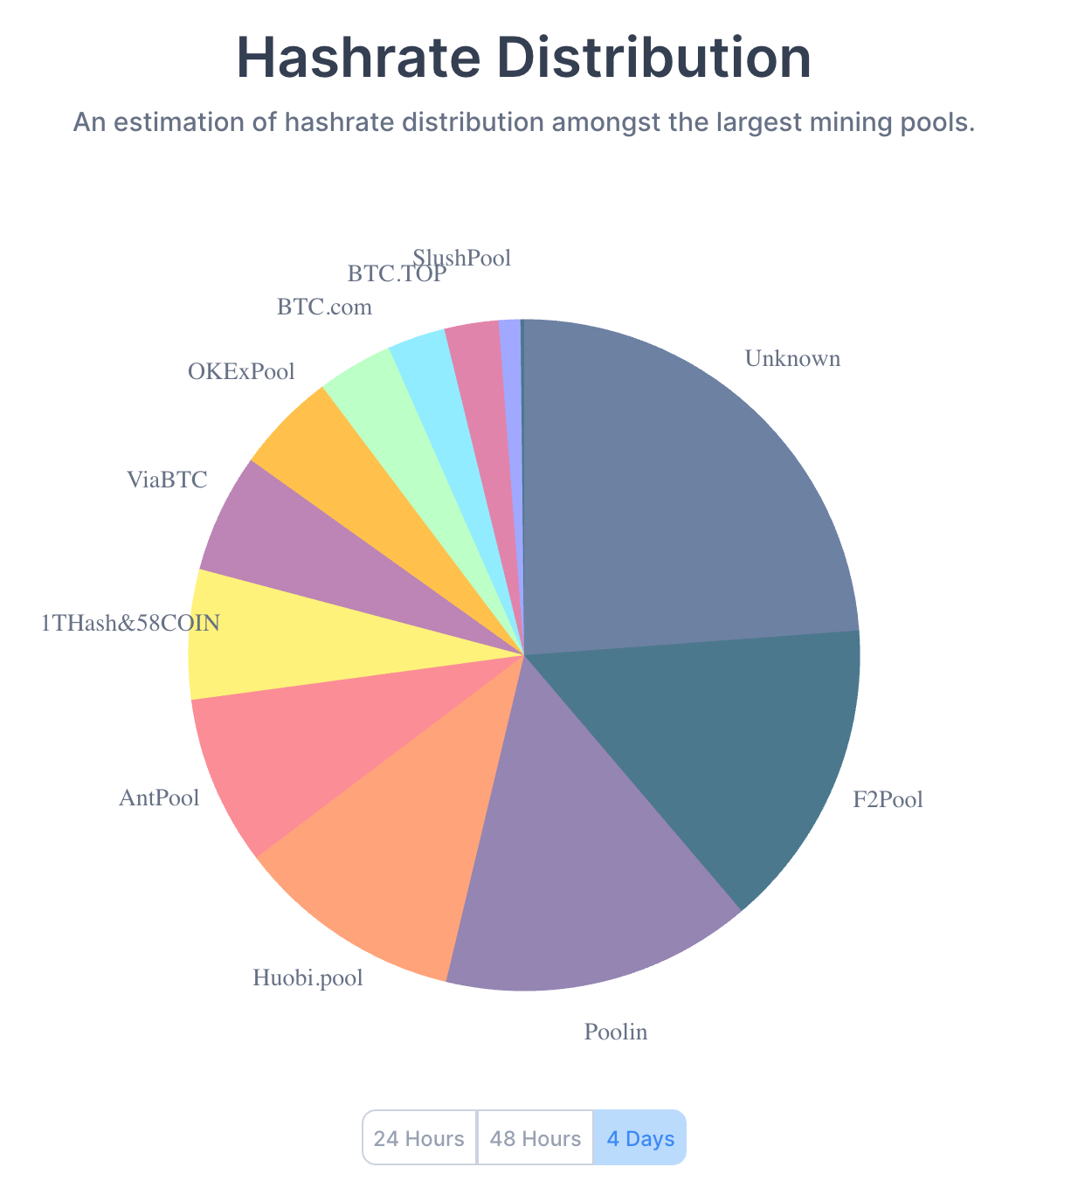
MINING SHARES
REAL WORLD MINING
Source: https://www.blockchain.com/charts/pools (10/2/2020)
Mining pools allow individual miners to combine, or 'pool', their computational power together
Reduces variance in mining rewards
Run by pool managers or pool operators
Pool manager usually takes a cut of the mining rewards
AUTHOR: MAX FANG

Slide 98
MINING POOL SCHEMES
REAL WORLD MINING
Miners in a pool submit shares (‘near-valid’ blocks) to the pool manager
Producing shares implies computational power being expended
Pool operator pays for valid shares
Rewards distributed proportional to # of shares submitted
Valid blocks are shares as well
Individual who finds valid block is not awarded any extra coins
AUTHOR: MAX FANG

Slide 99
OTHER REWARD SCHEMES
POOL REWARDS
Pay-per-share
Pool pays out at every share submitted. By default will be proportional to work done by individuals
More beneficial for miners
Individual miners have no risk from reward variance
Pool takes on the risk completely
Problem: No incentive for individuals to actually submit valid blocks
Individuals are paid regardless
Proportional
Pool pays out when blocks are found, proportional to the work individuals have submitted for this block
More beneficial for the pool
Individual miners still bear some risk in variance proportional to size of the pool
Not a problem if pool is sufficiently large
Lower risk for pool operators - only pay out when reward is found
Individuals thus incentivized to submit valid blocks
AUTHOR: MAX FANG

Slide 100
MINING POOLS
REAL WORLD MINING
CPPSRB - Capped Pay Per Share with Recent Backpay.
DGM - Double Geometric Method. A hybrid between PPLNS and Geometric reward types that enables to operator to absorb some of the variance risk. Operator receives portion of payout on short rounds and returns it on longer rounds to normalize payments.
ESMPPS - Equalized Shared Maximum Pay Per Share. Like SMPPS, but equalizes payments fairly among all those who are owed.
POT - Pay On Target. A high variance PPS variant that pays on the difficulty of work returned to pool rather than the difficulty of work served by pool
PPLNS - Pay Per Last N Shares. Similar to proportional, but instead of looking at the number of shares in the round, instead looks at the last N shares, regardless of round boundaries.
PPLNSG - Pay Per Last N Groups (or shifts). Similar to PPLNS, but shares are grouped into "shifts" which are paid as a whole.
RSMPPS - Recent Shared Maximum Pay Per Share. Like SMPPS, but system aims to prioritize the most recent miners first.
Score - Score based system: a proportional reward, but weighed by time submitted. Each submitted share is worth more in the function of time t since start of current round. For each share score is updated by: score += exp(t/C). This makes later shares worth much more than earlier shares, thus the miner's score quickly diminishes when they stop mining on the pool. Rewards are calculated proportionally to scores (and not to shares). (at slush's pool C=300 seconds, and every hour scores are normalized)
SMPPS - Shared Maximum Pay Per Share. Like Pay Per Share, but never pays more than the pool earns.
FPPS - Full Pay Per Share. Similar to PPS，but not only divide regular block reward (12.5 BTC for now) but also some of the transaction fees. Calculate a standard transaction fee within a certain period and distribute it to miners according to their hash power contributions in the pool. It will increase the miners' earnings by sharing some of the transaction fees.
AUTHOR: MAX FANG
Source: https://en.bitcoin.it/wiki/Comparison_of_mining_pools

Slide 101
MINING POOLS
REAL WORLD MINING
Source: https://www.blockchain.com/charts/pools (10/2/2020)
Pros
Allows individual miners to participate
Easy to upgrade software changes
Cons
Pool manager must be trusted
Centralized
Enables a multitude of attacks
AUTHOR: MAX FANG
UPDATED: BRIAN HO

Slide 102
MINING POOLS
REAL WORLD MINING
Quick facts:
Today's (10/08/19) network hashrate: 94, 509, 815 TH/s
Mining Reward / yr = (1 yr / 10 mins) * 12.5 = 657k BTC / yr
Assume constant price of Bitcoin of $10,000
Suppose you want to start mining today.
Antminer S17: Costs $1500, 53 TH/s
% of network hashrate = (53 TH/s) /
(94, 509, 815 TH/s) = 0.000000560788316
Expected Annual Reward
0.000000560788316 * 657k /yr ≈ 0.36843 BTC / yr ≈ $3,053/ yr
AUTHOR: MAX FANG
UPDATED: BRIAN HO

Slide 103
MINING POOLS
REAL WORLD MINING
Solo mining
1 block mined per 2,426,566 blocks ⇒ 12.5 BTC every 16,851 days ⇒ $125,000 once every 46.2 years
Mining with mining pool
Assume pool has ⅙ network hashrate
Pool finds every 6th block ≈ 1 per hr
$1530.72 /yr / 8760 hrs/yr ≈ $0.17 every hour
Paradox:
The more secure Bitcoin gets, the greater the appeal for mining pools and centralization of computation power
AUTHOR: MAX FANG
UPDATED: BRIAN HO

Slide 105
Changing Bitcoin

Slide 106
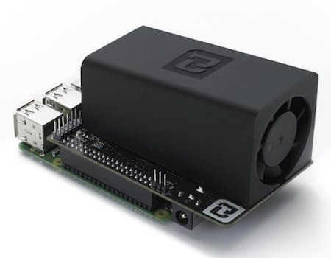
THE PROBLEM
DECENTRALIZING MINING
In practice, “One CPU One Vote” isn’t real
ASICs
Mining pools
Mining farms
Source: https://www.buybitcoinworldwide.com/wp-content/themes/kepler/img/miners/21.jpg
Source: https://www.theregister.co.uk/2014/08/12/chinese_bitcoin_farms_from_scifi_to_scuzzy/
Source: https://sc01.alicdn.com/kf/HTB18YN_JFXXXXcgXFXXq6xXFXXXw/221223714/HTB18YN_JFXXXXcgXFXXq6xXFXXXw.jpg
AUTHOR: RUSTIE LIN

Slide 107
PUZZLE REQUIREMENTS REVIEW
DECENTRALIZING MINING
A refresher on puzzle requirements:
Quick to verify
Adjustable difficulty
Computationally difficult
Solving rate proportional to computational power
“Progress free”
Pseudorandomly generated
Bitcoin’s puzzle is a “partial hash-preimage puzzle”
Doesn’t matter what follows the prerequisite number of zeros
AUTHOR: MAX FANG

Slide 108
ASIC-RESISTANCE
DECENTRALIZING MINING
Memory-hard: requires large amount of memory instead of computational power
Memory-bound: memory bottlenecks computation time
Memory-hard puzzles viably deter ASICs:
ASICs are optimized to execute a specific algorithm
Useless optimization if memory is the limiting agent
AUTHOR: MAX FANG

Slide 109





SCRYPT
DECENTRALIZING MINING
Scrypt (“ess crypt”): a hash function. The mining puzzle is the same partial hash-preimage puzzle.
Design considerations:
Used for hashing passwords
Hard to brute-force
Used by Litecoin and Dogecoin
AUTHOR: MAX FANG

Slide 110
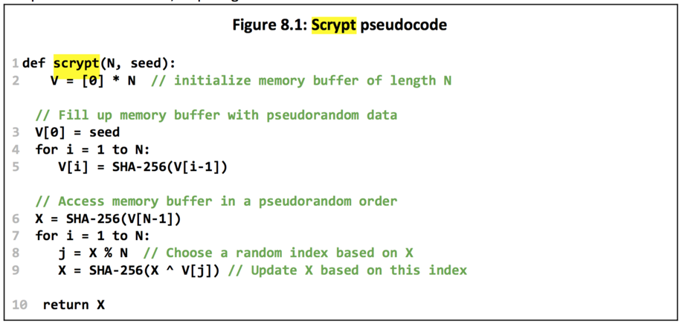
SCRYPT
DECENTRALIZING MINING
Two main steps:
Fill buffer w/ interdependent data
Access data in pseudorandom way
Without using memory, V[j], a previously computed value, must be computed on the fly.
Drawbacks:
Requires equal amount of memory to verify
ASIC developed; not resistant!
AUTHOR: MAX FANG

Slide 111
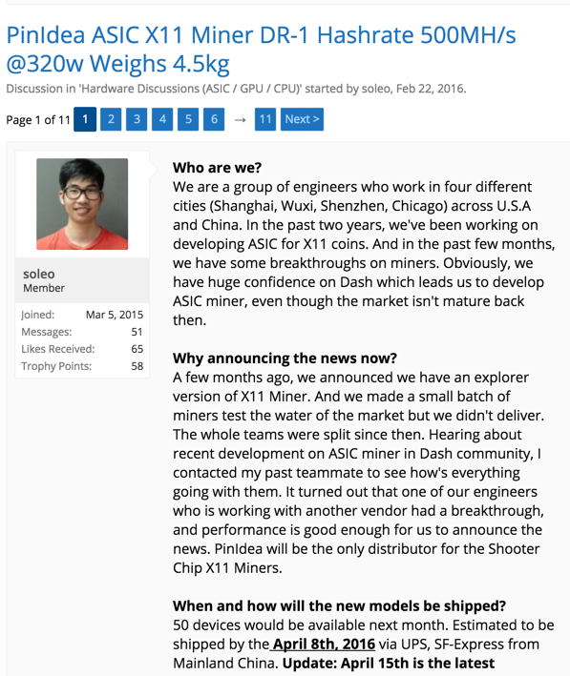
ASIC-RESISTANCE
DECENTRALIZING MINING
x11 or x13: Chain 11 or 13 different hash functions together respectively
Used by DASH
Significantly harder to design ASIC
...but not impossible, mind you
Periodically switching mining puzzle
Going from SHA-1 to SHA-3 to Scrypt for 6 months each
Not implemented
Mike Hearn, Bitcoin Core developer: “There’s really no such thing as an ASIC-resistant algorithm.”
AUTHOR: MAX FANG

Slide 112
ASIC-RESISTANCE
DECENTRALIZING MINING
Pros of ASIC-resistance:
ASICs dominate the network, suppressing regular people
Increase in democracy and decrease in centralization
Cons:
ASICs can only solve the puzzle, nothing more
Crash in exchange rate ⇒ useless electricity-gobbling hardware
AUTHOR: MAX FANG

Slide 113
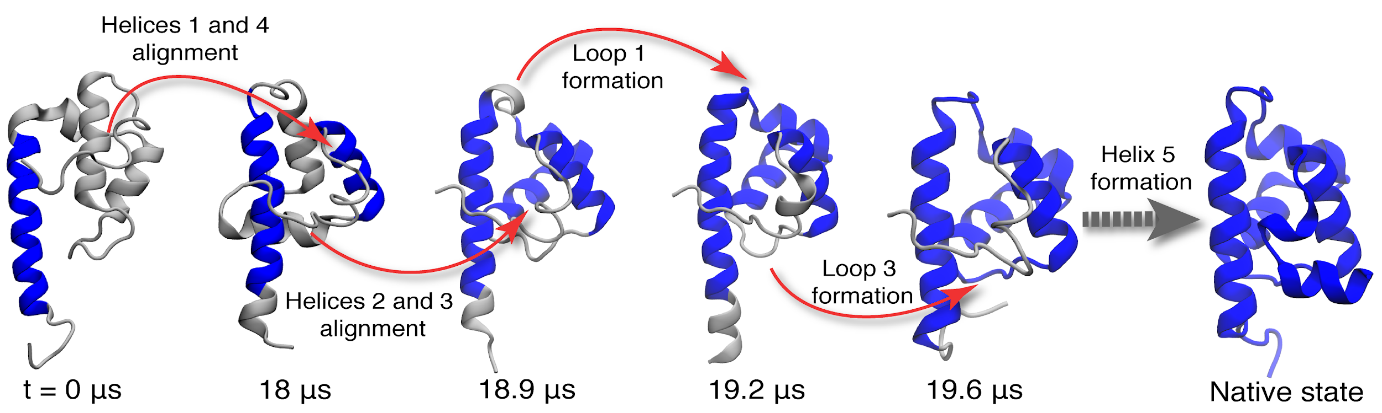
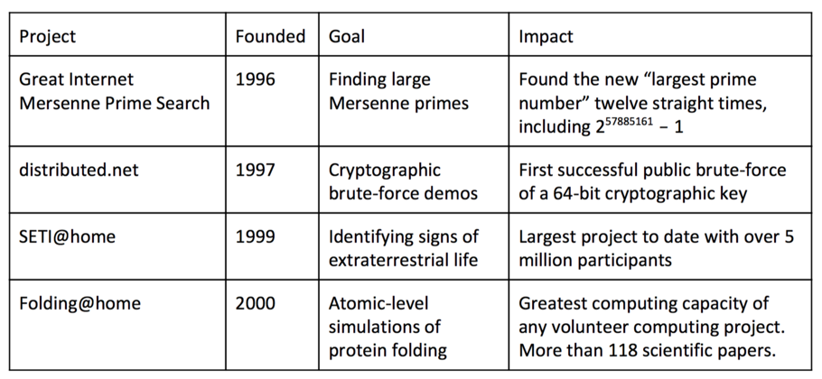
NOT A PUZZLING CONCEPT
PROOF-OF-USEFUL-WORK
“Repurpose” computing power
Examples:
Searching for large primes
Finding aliens
Simulating proteins at the atomic level
Generating predictive climate models
AUTHOR: MAX FANG

Slide 114
DOES IT WORK
PROOF-OF-USEFUL-WORK
Most distributed computing problems are unsuitable for proof-of-work
Fixed amount of data
Missing an inexhaustible puzzle space
Potential solutions not equally likely
Missing an equiprobable solution space
Cannot rely on central entity to delegate tasks
Missing decentralized algorithmically generated problem
In summary, Proof-of-Useful-Work does not work
AUTHOR: MAX FANG

Slide 115

BITCOIN CORE
CONSENSUS UPDATES
Bitcoin Core:
The team of developers in charge of the Bitcoin GitHub repo
The software designed by these developers used by full Bitcoin nodes
AUTHOR: MAX FANG

Slide 116


FORKS
CONSENSUS UPDATES
Hard Fork
Soft Fork
Source: Bitcoin.org Developer Guide
AUTHOR: MAX FANG

Slide 117

BITCOIN IMPROVEMENT PROPOSALS
CONSENSUS UPDATES
BIP: Bitcoin Improvement Proposal
Three types:
Standards Track BIPs
Informational BIPs
Process BIPs
First BIP proposed by Amir Taaki on 2011-08-19
Signal support for a BIP by including reference in block when mining
Source: https://en.bitcoin.it/wiki/Bitcoin_Improvement_Proposals
AUTHOR: NADIR AKHTAR

Slide 119

WALLET BACKUPS
BITCOIN WALLETS
AUTHOR: SUNNY AGGARWAL

